Slide 1



PFEM-based 2D phase change simulation tool applied to laser spot welding
funded by a F.N.R.S. FRIA research grant
Billy-Joe Bobach¹, billy-joe.bobach@uliege.be
Roman Boman¹
Prof. Diego Celentano²
Prof. Vincent Terrapon¹
Prof. Jean-Philippe Ponthot¹
¹Uliège Belgium; ²PUC Santiago de Chile

Slide 2
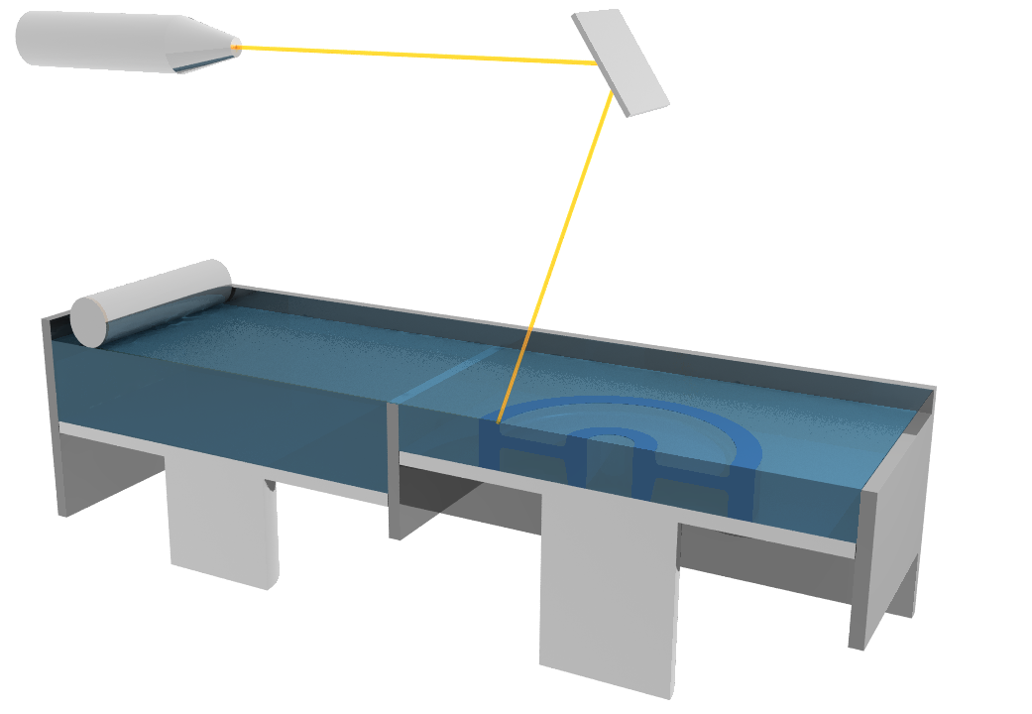
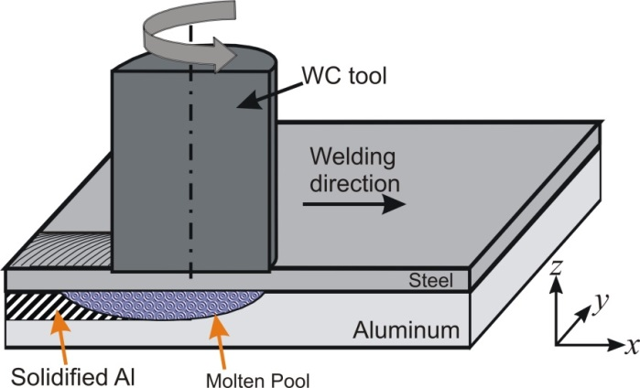
Additive Manufacturing
and related manufacturing processes
Common characteristics
  Localized/concentrated heat source
  Melting & resolidification
  Melt pool unknown & evolving
Presented today:
Laser spot welding
→ same characteristics, but simpler
Laser
Powder bed
Part
Future work in our lab
and many more...
van der Rest, Jacques, Simar, Scripta Materialia 2014
Example: Selective Laser Melting (SLM)
Example: Friction Melt Bonding (FMB)

Slide 3
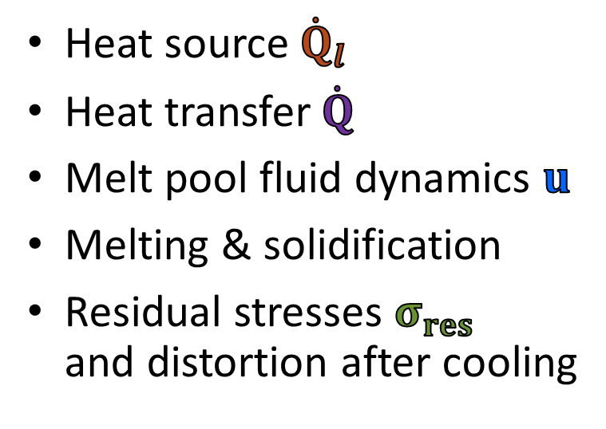
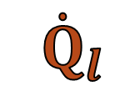


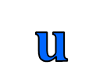
multi-physics simulation at meso-scale
$${\dot{Q}}_{l}$$
Liquid
$$u$$
Liquid
$$\dot{Q}$$
$$σ_{res}$$
Solid
Solid
Laser (stationary for spot welding)
Heat source${\dot{Q}}_{l}$
Heat transfer$\dot{Q}$
Melt pool fluid dynamics $u$
Melting & solidification
Residual stresses $σ_{res}$
and distortion after cooling
transient & coupled
unknown & evolving
Interfaces

Slide 4
Proposed approach
Particle finite element method (PFEM)
First developments: Idelsohn et al., Int. J. Num. Methods Eng., 2004
Comprehensive review: Cremonesi et al., Arch. Comput. Methods Eng., 2020
Robust as FEM
Flexible as a particle method
Well suited for free surface
Not been used in this context

Slide 5
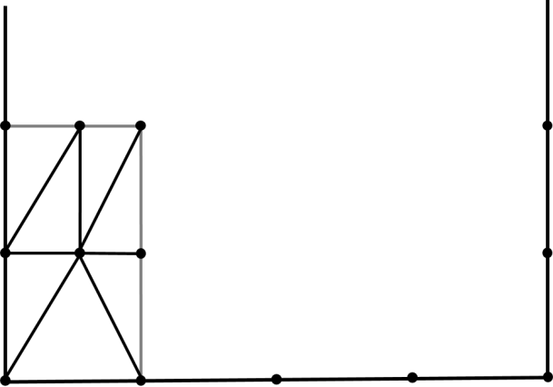
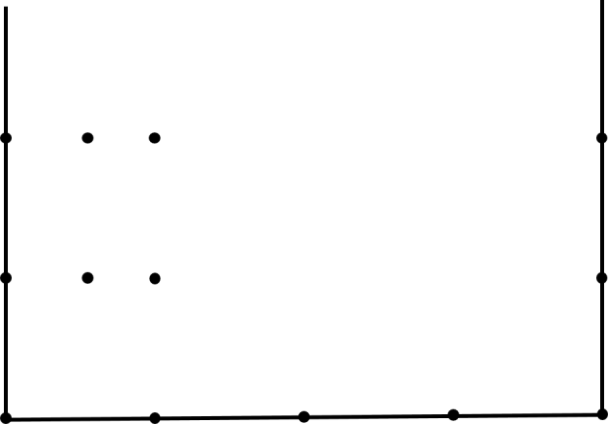
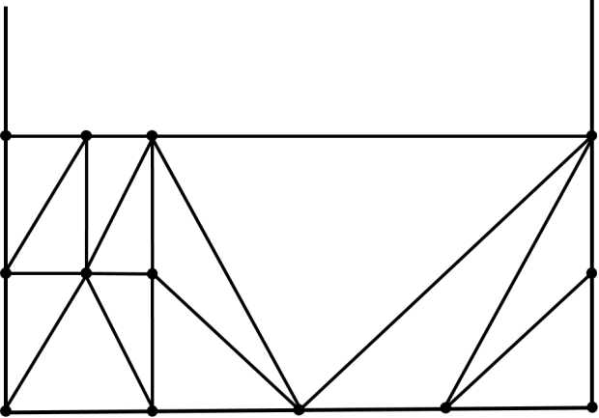
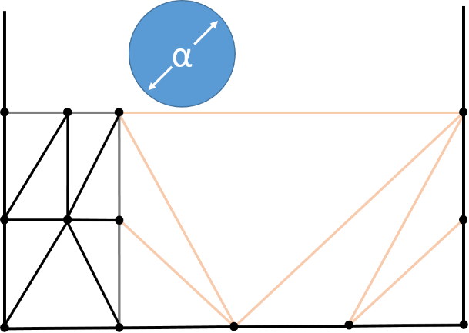
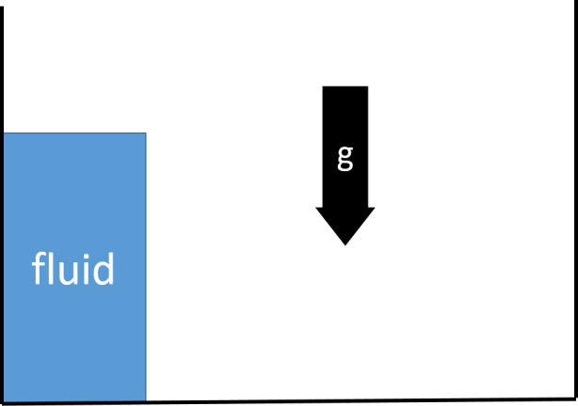
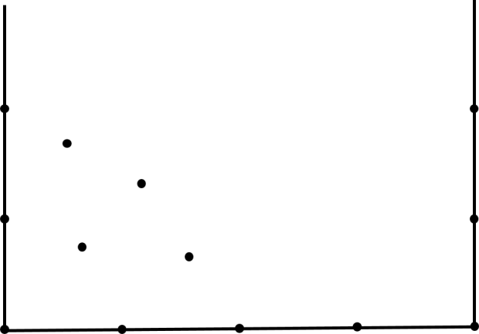
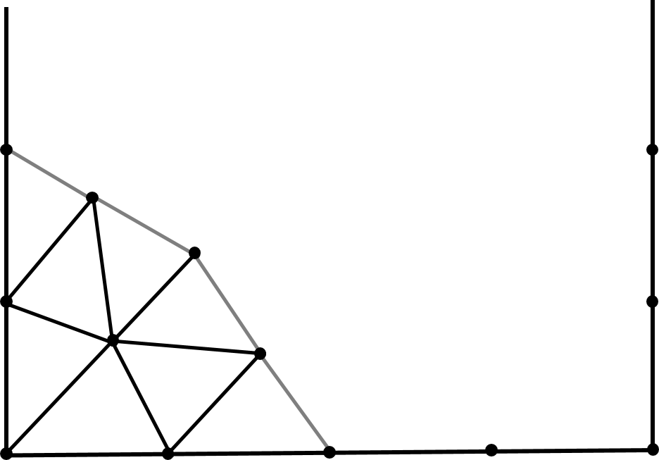
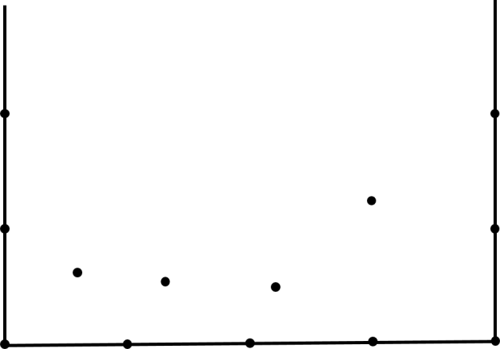
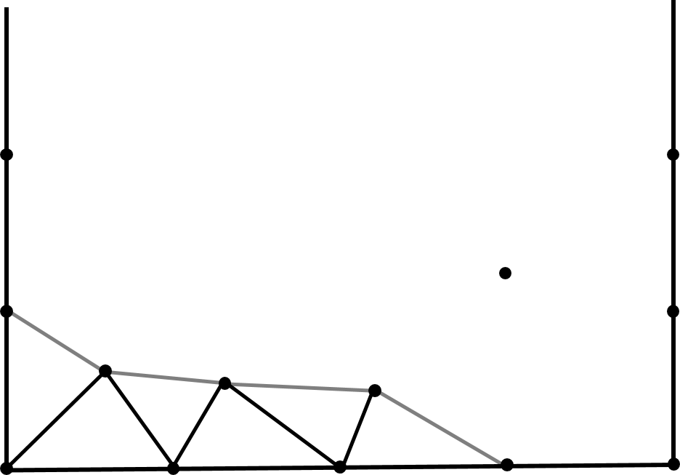

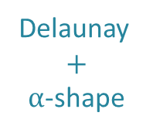

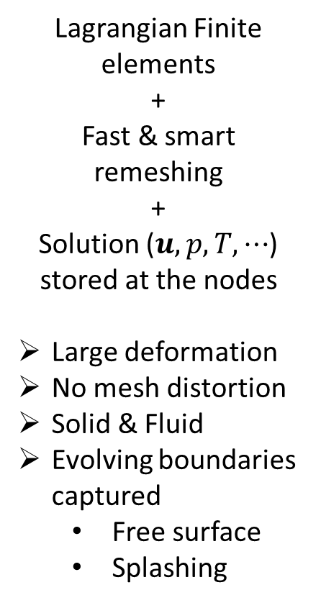

PFEM explained: example dam break
Nodes
Delaunay
-shape
$$t_{n}$$
Meshing
Lagrangian Finite elements
+
Fast & smart remeshing
+
Solution ($u,p,T,⋯$) stored at the nodes
Large deformation
No mesh distortion
Solid & Fluid
Evolving boundaries captured
  Free surface
  Splashing
Delaunay
+
$α$-shape
FEM
deform
$$t_{n+1}$$
FEM
deform
$$t_{n+2}$$

Slide 6
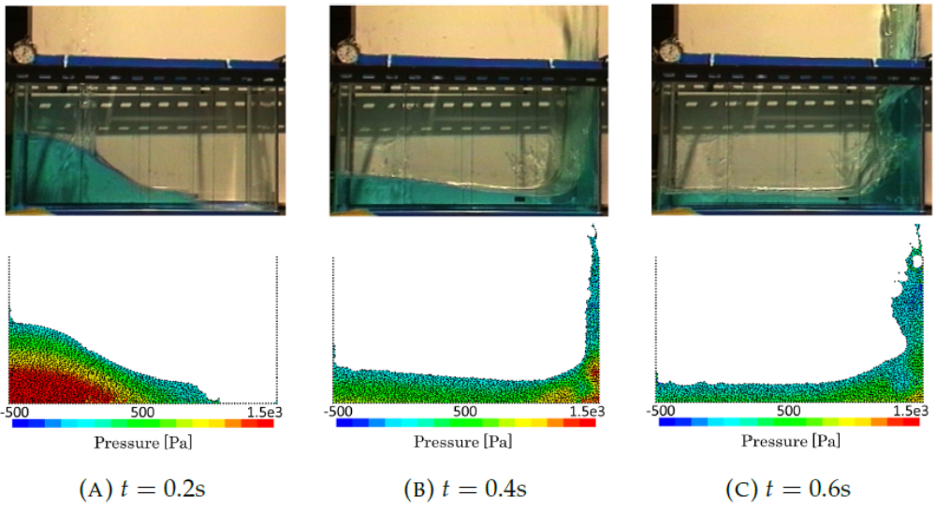
PFEM explained: example dam break
M. Cerquaglia, Doctoral thesis ULiège, 2019

Slide 7
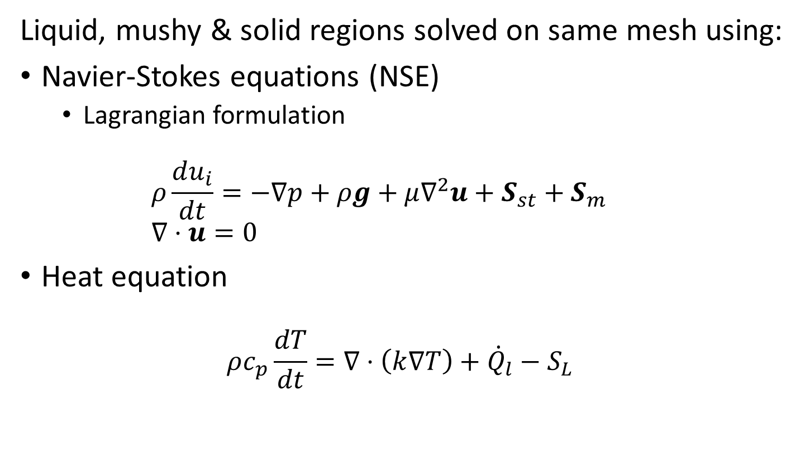
Equations to solve
Liquid, mushy & solid regions solved on same mesh using:
Navier-Stokes equations (NSE)
  Lagrangian formulation
  $ρ\frac{du_{i}}{dt}=−∇p+ρg+μ∇^{2}u+S_{st}+S_{m}$
  $∇⋅u=0$
Heat equation
$ρc_{p}\frac{dT}{dt}=∇⋅\left(k∇T\right)+{\dot{Q}}_{l}−S_{L}$
Surface tension
flow resistance
of mushy zone (and solid)
Laser heat source
Latent heat absorption

Slide 8
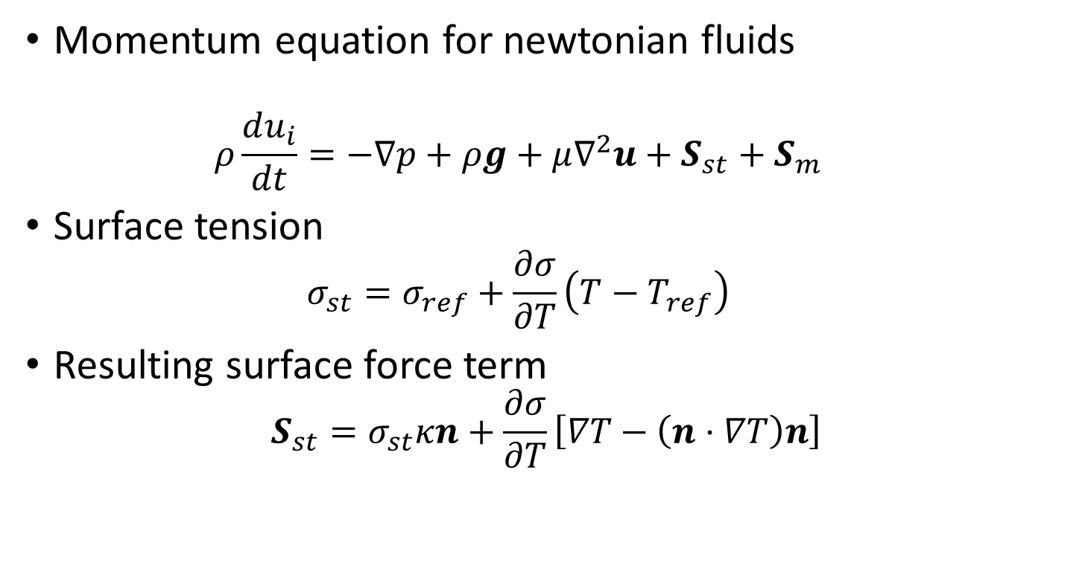
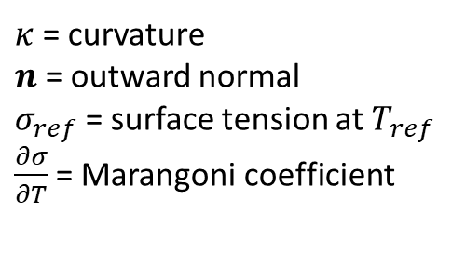
Equations to solve
$κ$ = curvature
$n$ = outward normal
$σ_{ref}$ = surface tension at $T_{ref}$
$\frac{∂σ}{∂T}$= Marangoni coefficient
Surface tension term
Momentum equation for newtonian fluids
  $$ρ\frac{du_{i}}{dt}=−∇p+ρg+μ∇^{2}u+S_{st}+S_{m}$$
Surface tension
  $$σ_{st}=σ_{ref}+\frac{∂σ}{∂T}\left(T−T_{ref}\right)$$
Resulting surface force term
$$S_{st}=σ_{st}κn+\frac{∂σ}{∂T}\left[∇T−\left(n⋅∇T\right)n\right]$$
Note:
Marangoni coefficient usually negative
→ surface force away from heat source
Normal force
Tangential marangoni force

Slide 9

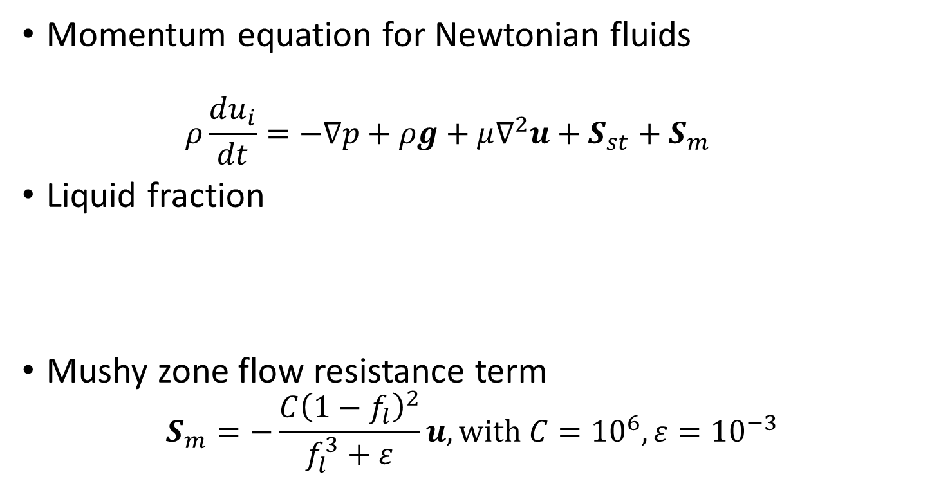


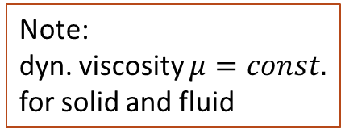
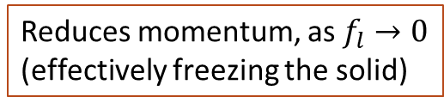
Equations to solve
Note:
dyn. viscosity $μ=const.$ for solid and fluid
Solidification flow resistance tension term
Momentum equation for Newtonian fluids
  $$ρ\frac{du_{i}}{dt}=−∇p+ρg+μ∇^{2}u+S_{st}+S_{m}$$
Liquid fraction
Mushy zone flow resistance term
$$S_{m}=−\frac{C{\left(1−f_{l}\right)}^{2}}{f_{l}^{3}+ε}u, \text{with} C={10}^{6}, ε={10}^{−3}$$
$$f_{l}$$
Reduces momentum, as $f_{l}→0$
(effectively freezing the solid)
1
0
$$T_{m}$$
$$T$$
Chosen coefficient
Avoid
div. by 0
Carman-Kozeny eq.

Slide 10
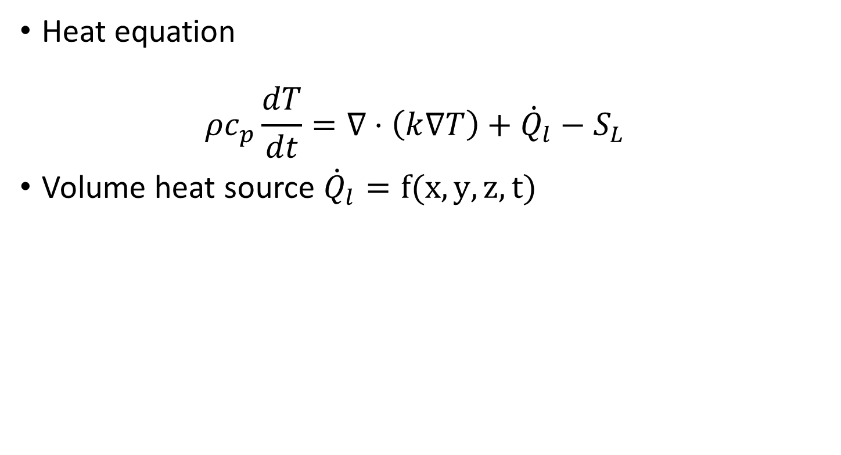
Equations to solve
Heat source term
Heat equation
$ρc_{p}\frac{dT}{dt}=∇⋅\left(k∇T\right)+{\dot{Q}}_{l}−S_{L}$
Volume heat source ${\dot{Q}}_{l}=f(x,y,z,t)$

Slide 11

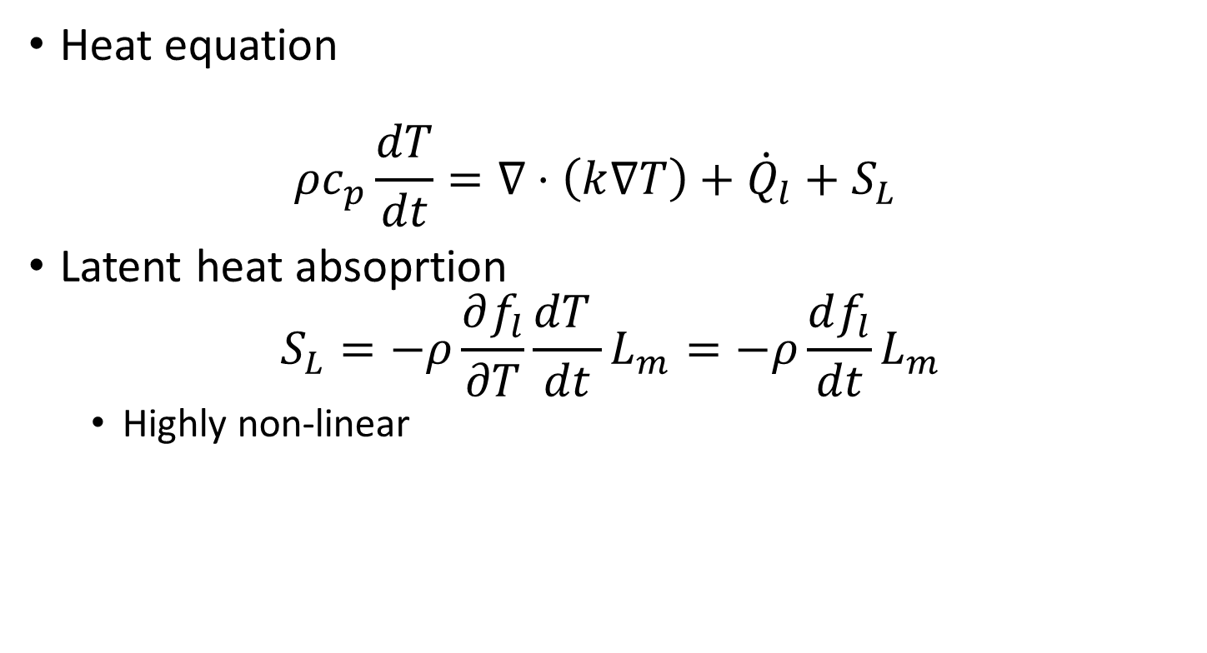






Equations to solve
Latent heat term
Heat equation
$ρc_{p}\frac{dT}{dt}=∇⋅\left(k∇T\right)+{\dot{Q}}_{l}+S_{L}$
Latent heat absoprtion
$S_{L}=−ρ\frac{∂f_{l}}{∂T}\frac{dT }{dt}L_{m}=−ρ\frac{df_{l}}{dt}L_{m}$
  Highly non-linear
would be +inf
Can become very large
$$f_{l}$$
$$T_{m}$$
$$T$$
0
1
as $Δt→0$
→Improve stability using regularization
0
$$T_{m}$$
$$T$$
$$S_{L}$$

Slide 12

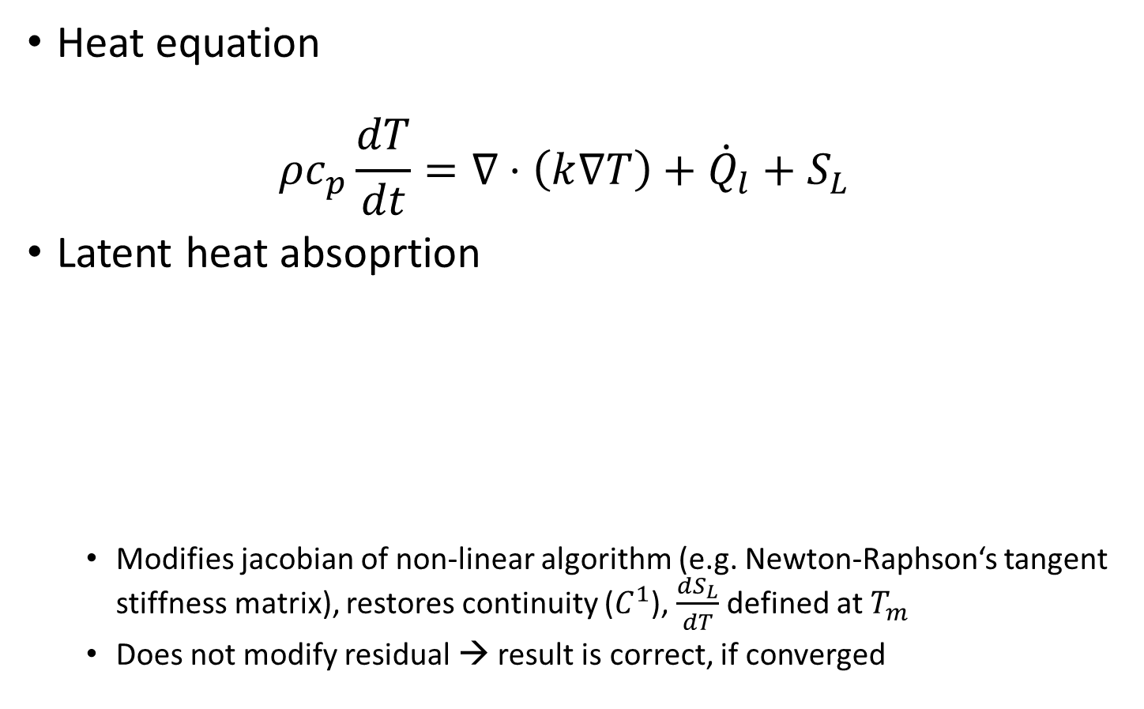





Equations to solve
Latent heat term
Heat equation
$ρc_{p}\frac{dT}{dt}=∇⋅\left(k∇T\right)+{\dot{Q}}_{l}+S_{L}$
Latent heat absoprtion
  Modifies jacobian of non-linear algorithm (e.g. Newton-Raphson‘s tangent stiffness matrix), restores continuity ($C^{1}$), $\frac{dS_{L}}{dT}$ defined at $T_{m}$
  Does not modify residual → result is correct, if converged
$$f_{l}$$
$$f_{l}$$
Cubic polynomial
Regularization
1
1
0
0
$$T_{m}$$
$$T$$
$$T_{m}$$
$$T$$

Slide 13
Numerics
time integration: Backward Euler fully implicit
solution scheme: staggered, weakly coupled
non-linear algo: Newton-Raphson for heat eq.
Picard iterations for NSE
+ line search algo (faster convergence)
element type: linear triangles (3 nodes)
3 Gauss points (required near sym. axis)
Pressure-Stabilizing Petrov-Galerkin
one time step
Heat eq.
Converged?
N-S eq.
Converged?
iterate
iterate
$→$see e.g. Cerquaglia, M., PhD thesis ULiège, 2019

Slide 14
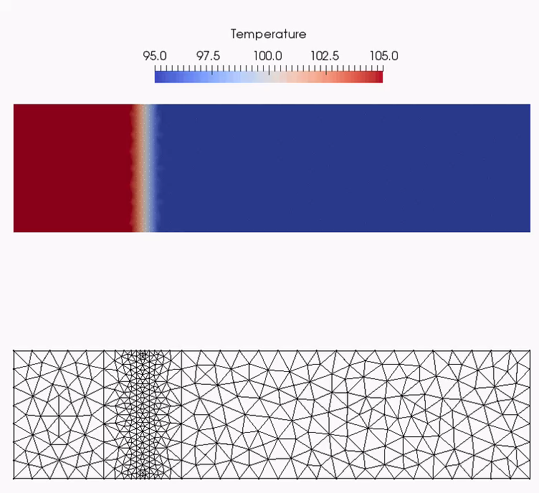



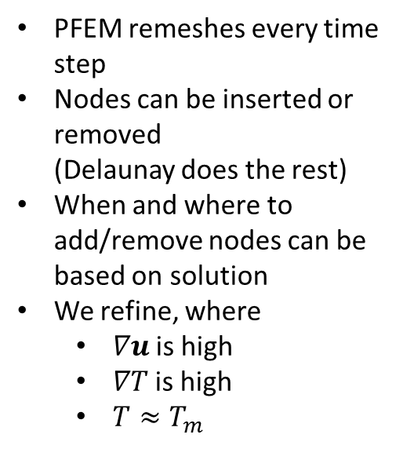
Adaptive mesh refinement
(using simple example: imposed T field with a gradient)
PFEM remeshes every time step
Nodes can be inserted or removed
(Delaunay does the rest)
When and where to add/remove nodes can be based on solution
We refine, where
  $∇u$is high
  $∇T$is high
  $T≈T_{m}$
$$∇T=0$$
$$∇T=0$$
$$∇T≠0$$
Note:
based on work by R. Falla, Uliège.
Paper not yet submitted

Slide 15




Laser Spot welding test case
Simulations by Saldi, Z., PhD thesis TU Delft, 2012
Experiments by Pitscheneder et al., Supplement to the welding Journal, 1996
$$d=2.8mm$$
$${\dot{Q}}_{l}$$
Total time: 5s
No atmosphere modeled
Steel
$$h=15mm$$
$$d=30mm$$

Slide 16
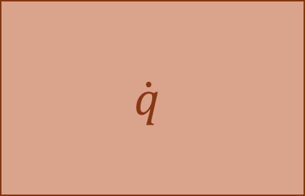


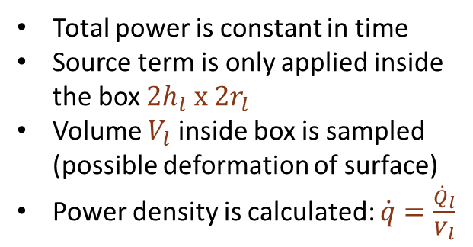

Heat source
Total power is constant in time
Source term is only applied inside the box $2h_{l} x 2r_{l}$
Volume $V_{l}$ inside box is sampled
(possible deformation of surface)
Power density is calculated: $\dot{q}=\frac{{\dot{Q}}_{l}}{V_{l}}$
$${\dot{Q}}_{l} =3850W$$
Steel
$$\dot{q}$$
$$h_{l}=0.2mm$$
$$r_{l}=1.4mm$$
Note:
Power density is constant in space inside box
No attenuation in depth (e.g. Beer-Lambert)
No variation over radius (e.g. Gaussian distr.)

Slide 17
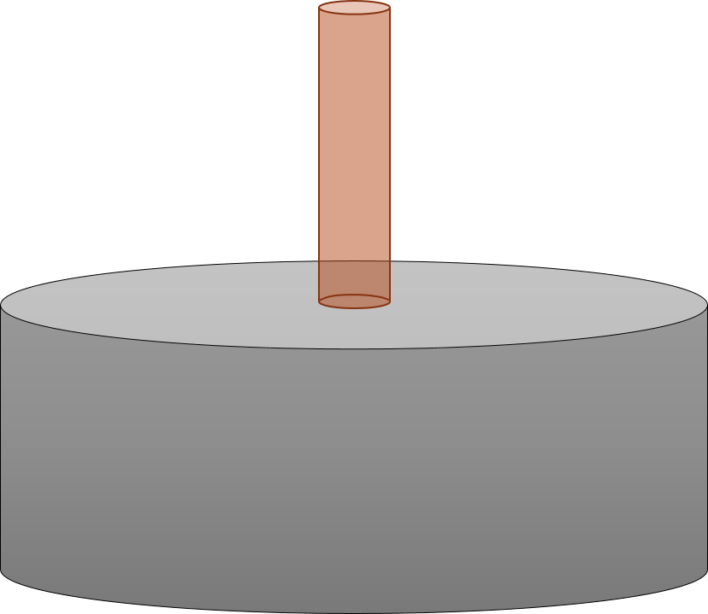


Simulation setup
Total time: 5s
Time step: 1ms
$$y$$
Volume heat source
Adiabatic, free surface
Use axisymmetry
axisymmetry
Adiabatic
rigid
Adiabatic, rigid
$$x$$

Slide 18
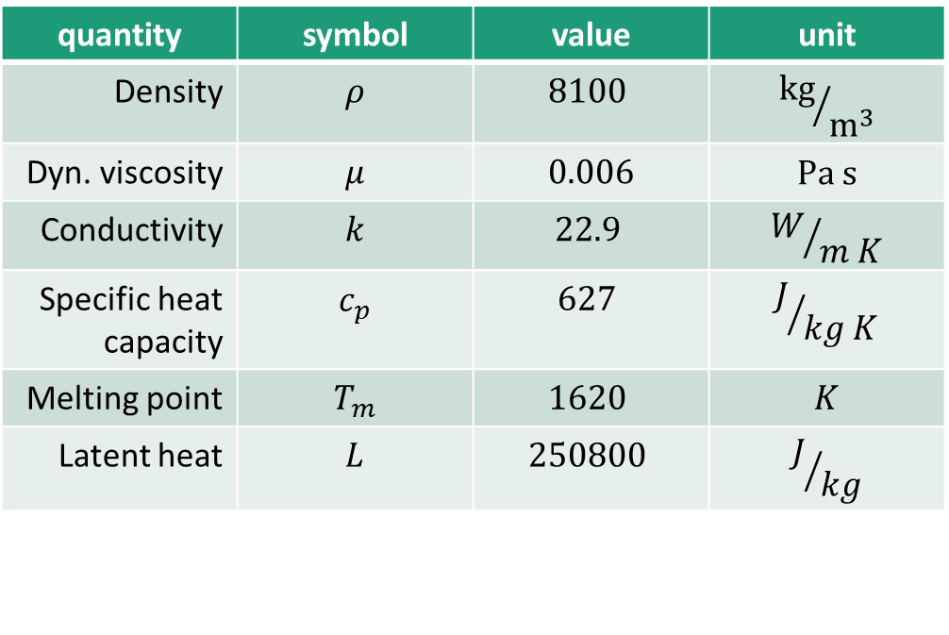
Properties
Steel
quantity | symbol | value | unit
Density | $$ρ$$ | $$8100$$ | $${kg}/{m^{3}}$$
Dyn. viscosity | $$μ$$ | $$0.006$$ | $$Pa s$$
Conductivity | $$k$$ | $$22.9$$ | $$W/{m K}$$
Specific heat capacity | $$c_{p}$$ | $$627$$ | $$J/{kg K}$$
Melting point | $$T_{m}$$ | $$1620$$ | $$K$$
Latent heat | $$L$$ | $$250800$$ | $$J/{kg}$$

Slide 19
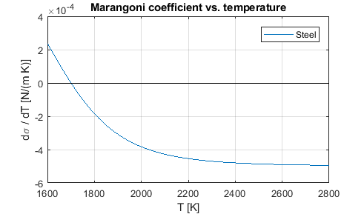
Properties
Note:
Surface tension normal force is neglected in this case (following reference test case by Saldi)

Slide 20
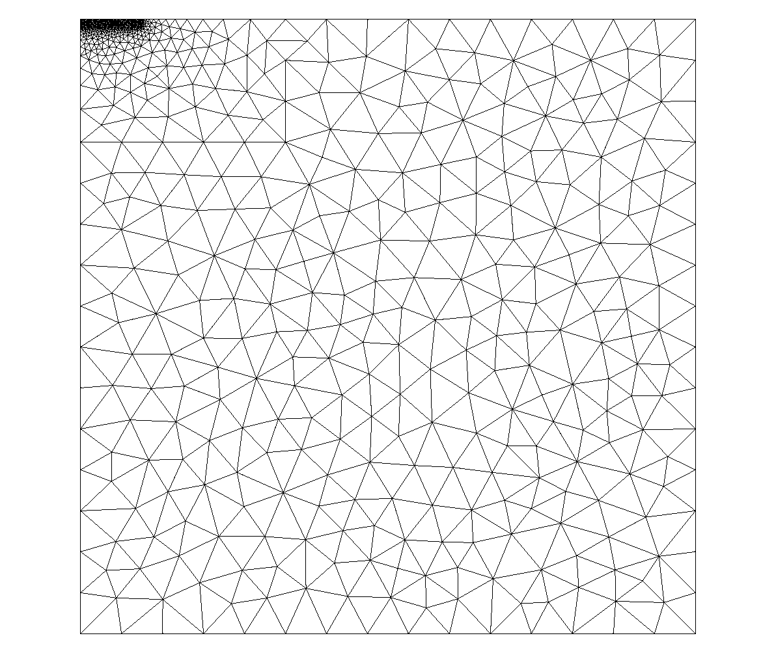
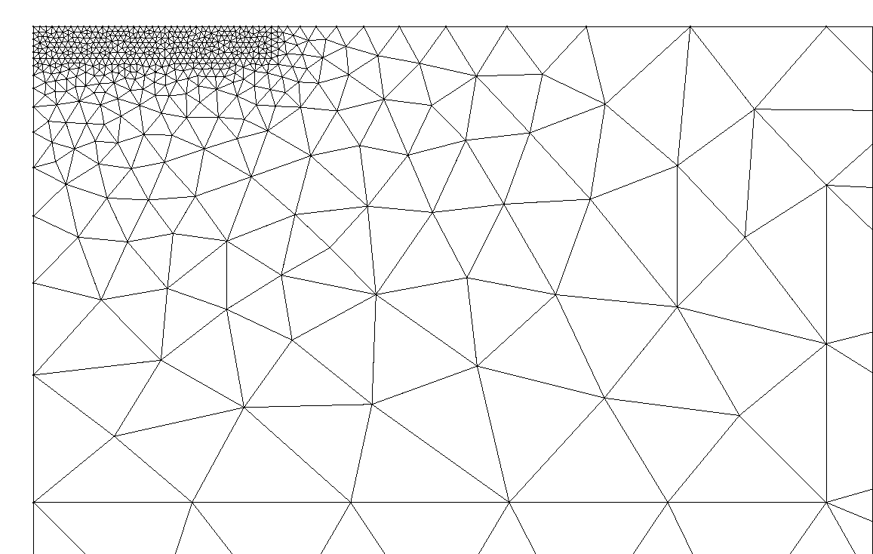



Initial mesh
Coarse: $≈1mm$
$$1.6mm$$
Fine: $≈0.02mm$
Simulation results will show this top left corner!

Slide 21
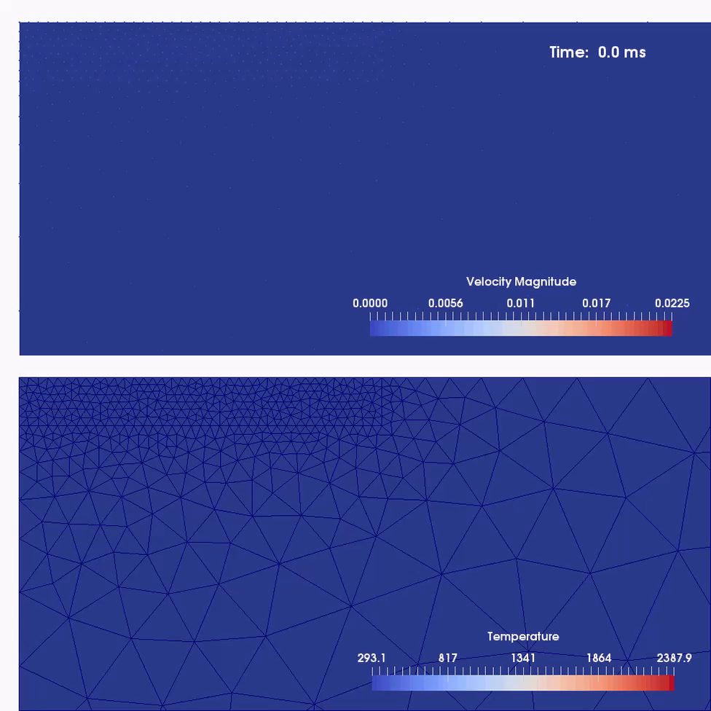
No flow
Liquid
Mushy
Solid

Slide 22
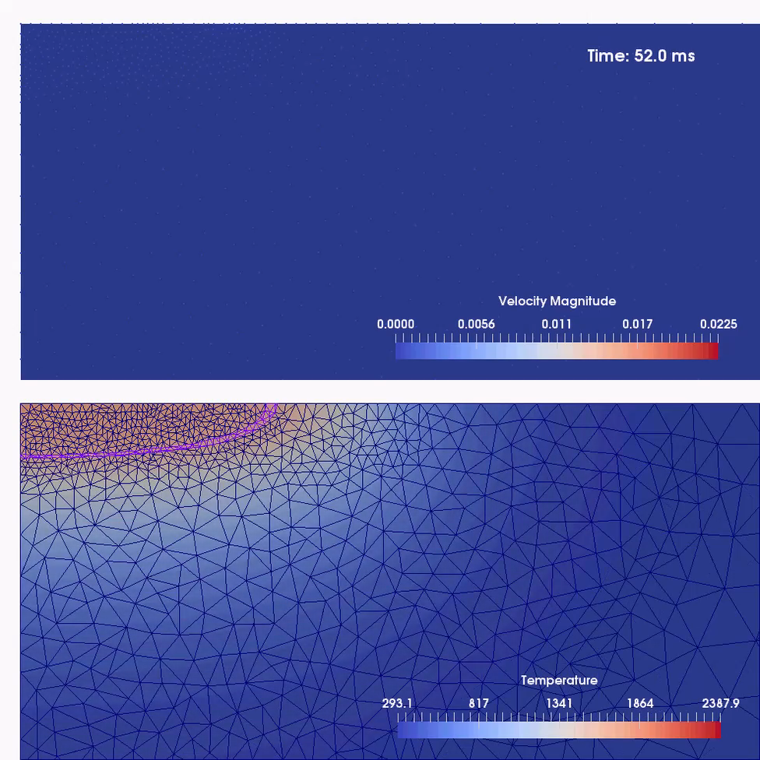
Liquified portion of surface is deforming under Marangoni force
Melting front advancing
and fine mesh follows

Slide 23
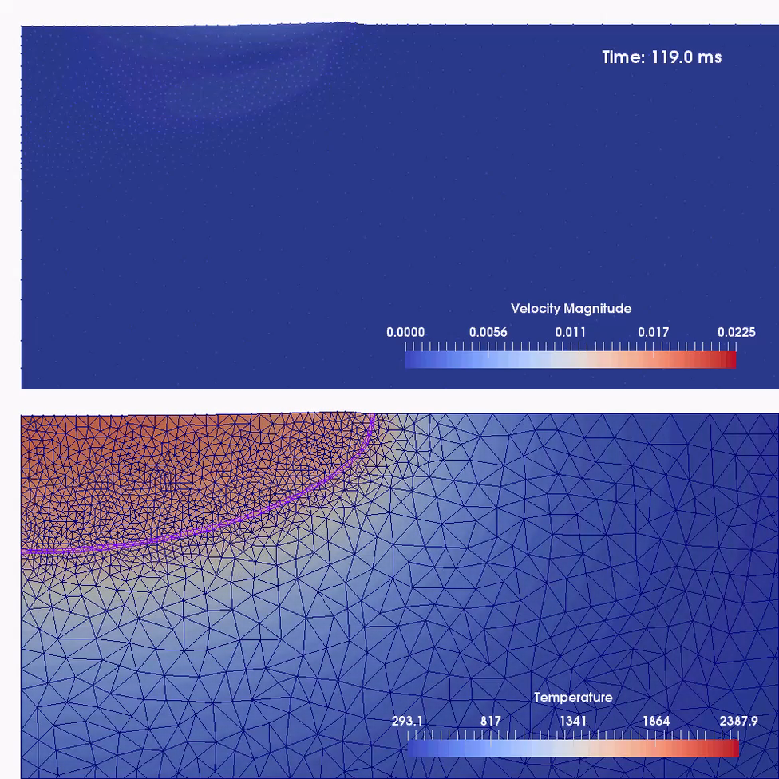
Liquid material builds up at the free surface and freezes again at melting front
Convective flow sets in, driven by Marangoni force at surface

Slide 24
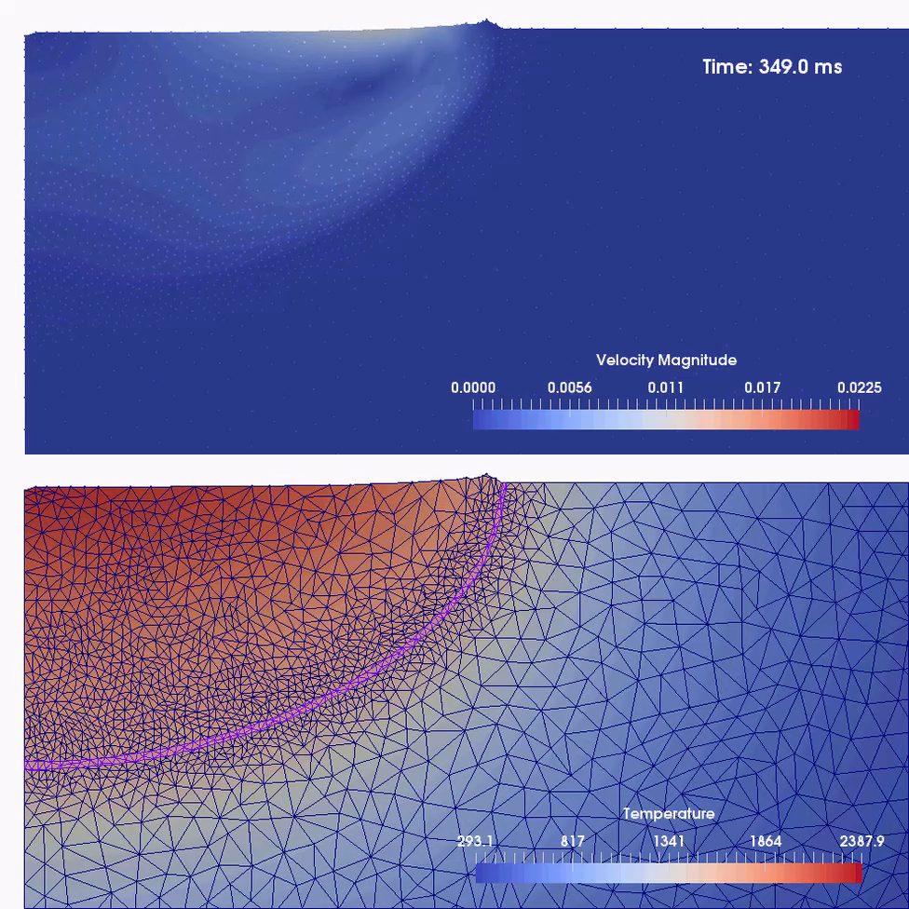
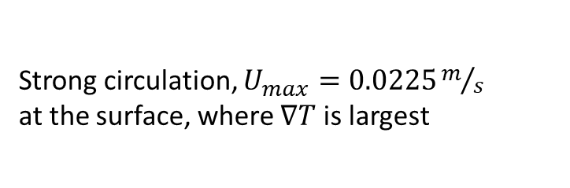
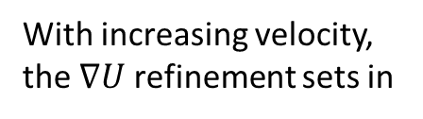
Strong circulation, $U_{max}=0.0225m/s$ at the surface, where $∇T$ is largest
With increasing velocity, the $∇U$ refinement sets in
Melting front advancement slows down significantly

Slide 25
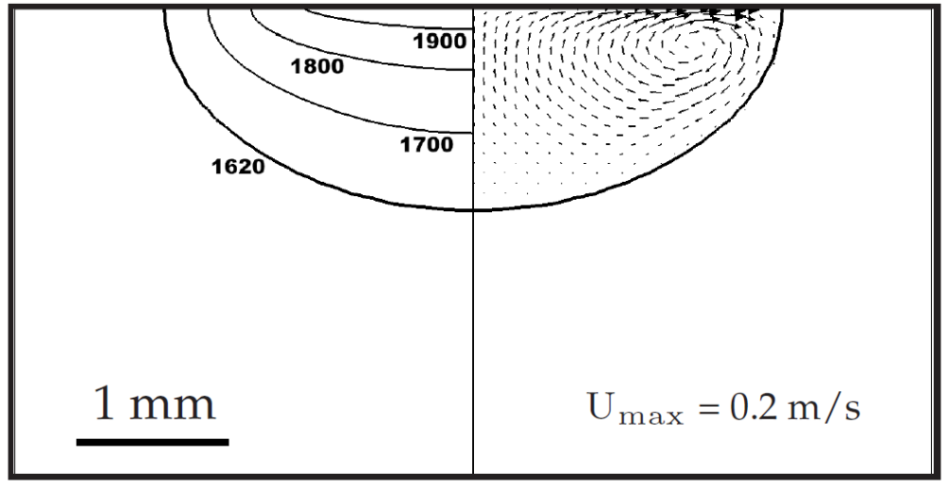
Comparison with literature
Saldi, 2012 (Simulation)
Temperature field
Velocity vectors
After 5s

Slide 26
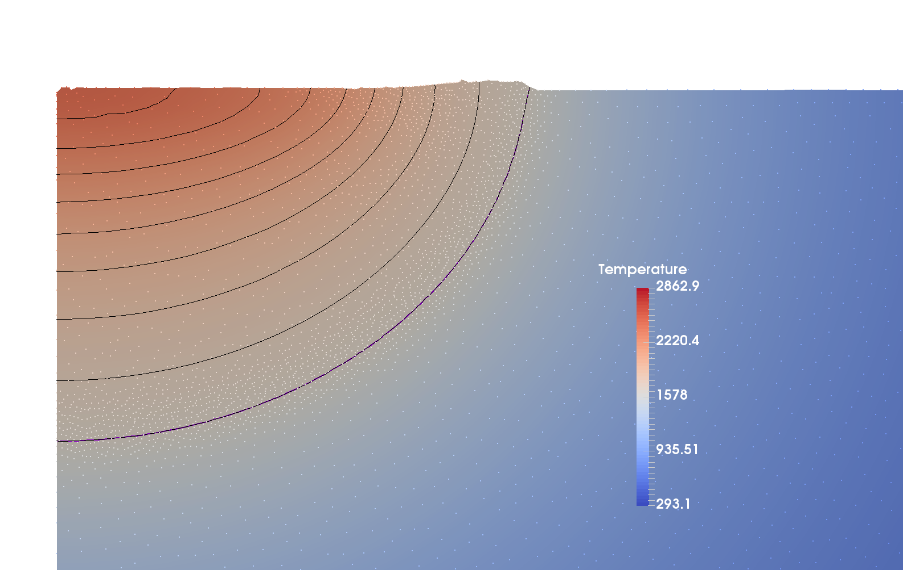






Comparison with literature
Saldi, 2012 (Simulation)
$$r_{Saldi}=2.02mm$$
$$r_{Bobach}=2.23mm$$
2000
1900
1800
$$h_{Saldi}=1.34mm$$
1700
Temperature field
1620
$$h_{Bobach}=1.67mm$$
Velocity vectors
After 5s
$$T_{max}≈2000K$$
$$T_{max}=2862.9K$$

Slide 27
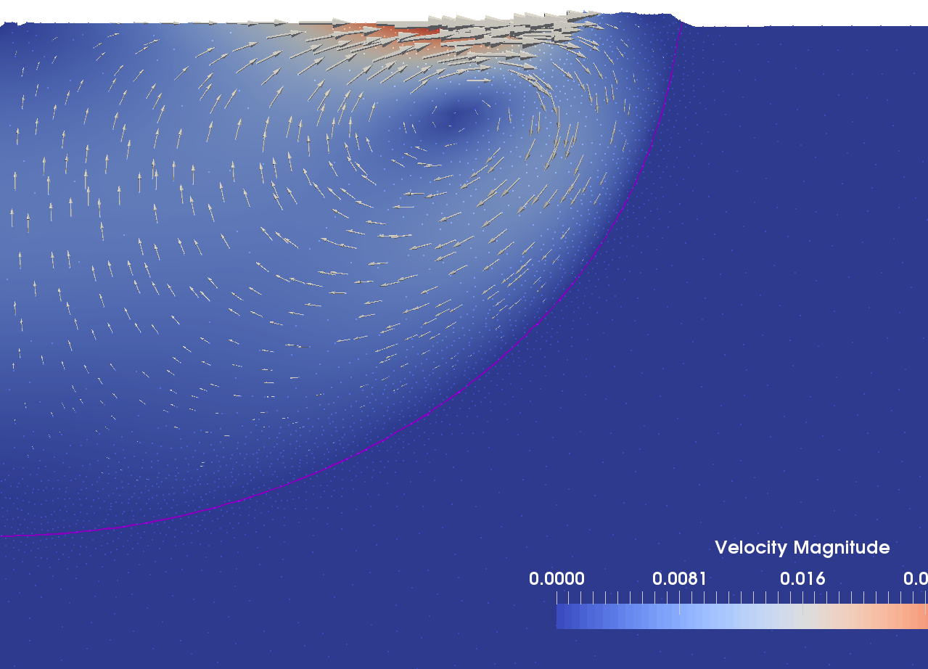
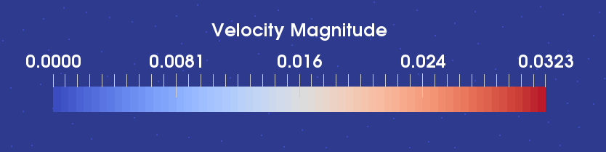
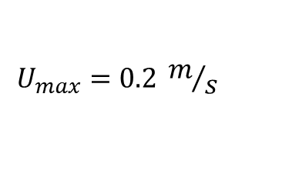
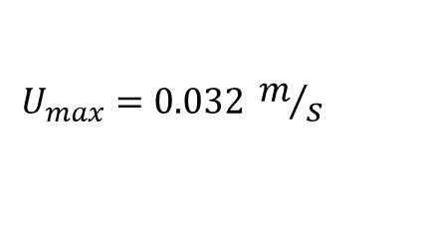
Comparison with literature
Note: deformation of free surface
Saldi, 2012 (Simulation)
$$U_{max}=0.2 m/s$$
$$U_{max}=0.032 m/s$$
Velocity vectors
After 5s

Slide 28
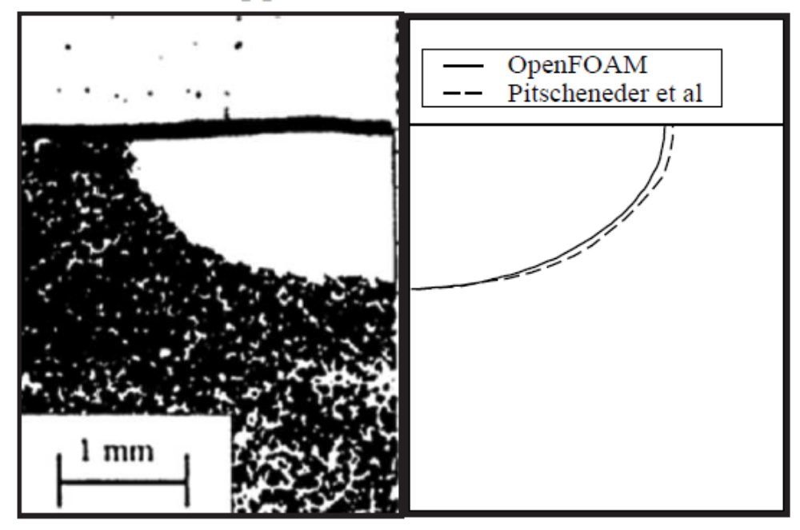
Comparison with literature
Saldi, 2012 (Simulation)
Pitscheneder et al. 1996 (Exp.)
deformation of free surface
No deformation of free surface
After 5s

Slide 29
Comparison with literature
Saldi, 2012 (Simulation)
Pitscheneder et al. 1996 (Exp.)
deformation of free surface
deformation of free surface, but different than experiment
After 5s

Slide 30
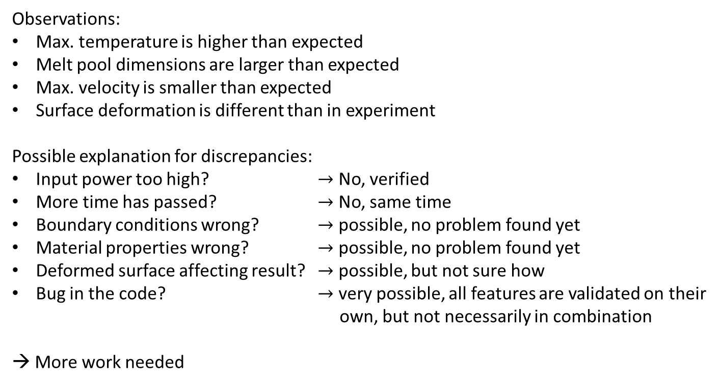
Comparison with literature
Observations:
Max. temperature is higher than expected
Melt pool dimensions are larger than expected
Max. velocity is smaller than expected
Surface deformation is different than in experiment
Possible explanation for discrepancies:
Input power too high? $→$ No, verified
More time has passed? $→$ No, same time
Boundary conditions wrong? $→$ possible, no problem found yet
Material properties wrong? $→$ possible, no problem found yet
Deformed surface affecting result? $→$ possible, but not sure how
Bug in the code? $→$ very possible, all features are validated on their
own, but not necessarily in combination
→ More work needed

Slide 31
Conclusion
These particular results are not reliable, but
PFEM handles well
  free surface deformation
  phase change with latent heat
  surface tension & Marangoni effect
  adaptive mesh refinement

Slide 32
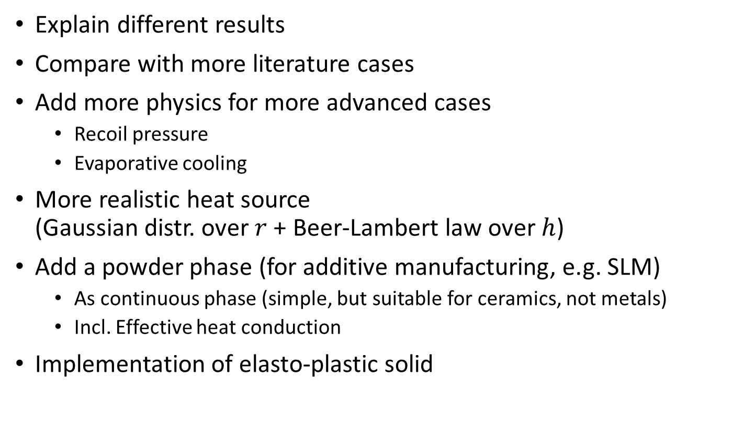
Future work
Explain different results
Compare with more literature cases
Add more physics for more advanced cases
  Recoil pressure
  Evaporative cooling
More realistic heat source
(Gaussian distr. over $r$ + Beer-Lambert law over $h$)
Add a powder phase (for additive manufacturing, e.g. SLM)
  As continuous phase (simple, but suitable for ceramics, not metals)
  Incl. Effective heat conduction
Implementation of elasto-plastic solid

