Slide 1

Continuum Damage Models in a Ceramic Matrix Composite Context
29/01/2021
Gabriel Tanaka Nunes

Slide 2
Smeared Crack Approach
Evolution of the approach
Originally proposed by Y. Rashid in his historical paper “Analysis of prestressed concrete pressure vessels. Nuclear Engineering and Design 1968; 7:334–344”.
  The cracked material is assumed to remain a continuum and the mechanical properties (stiffness and strength) are modified to account for the effect of cracking, according to the evolving states of strain and/or stress.
  Great acceptance from the engineering community due to its simplicity.
  Problem: if a smeared crack is only one element across, the total energy dissipated in the cracking process is proportional to the size (the volume) of the element
  Consequence: Upon mesh refinement, for infinitesimally small elements, the dissipated energy vanishes
Landmark paper by Bažant and Oh 1983 introducing the Crack Band Theory
  Strain Softening after cracking no longer considered as a characteristic of the material
  A relation between the fracture energy of the material and the size of the FE crossed by the smeared crack governs the strain softening
  Mesh size dependance satisfactorily overcome
Cervera, M., & Chiumenti, M. (2006). Smeared crack approach: Back to the original track. International Journal for Numerical and Analytical Methods in Geomechanics, 30(12), 1173–1199. https://doi.org/10.1002/nag.518

Slide 3
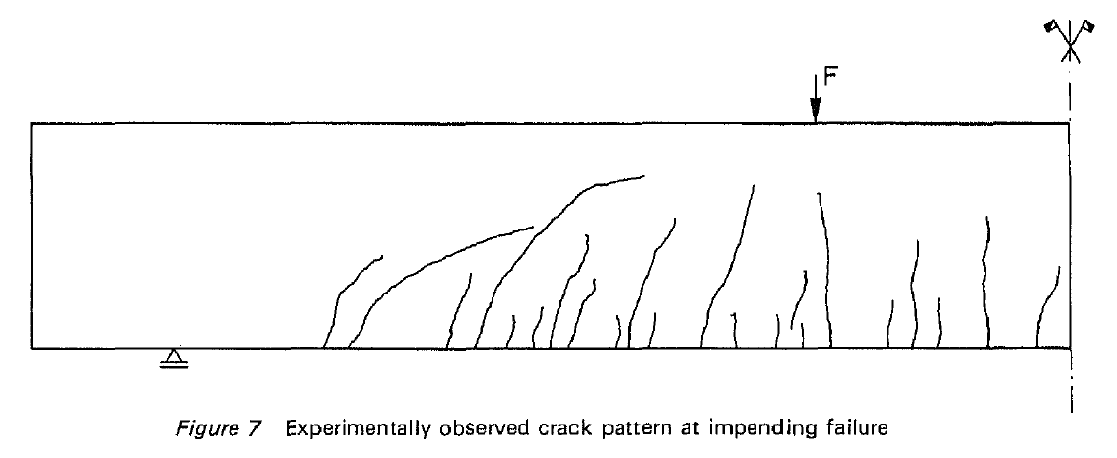
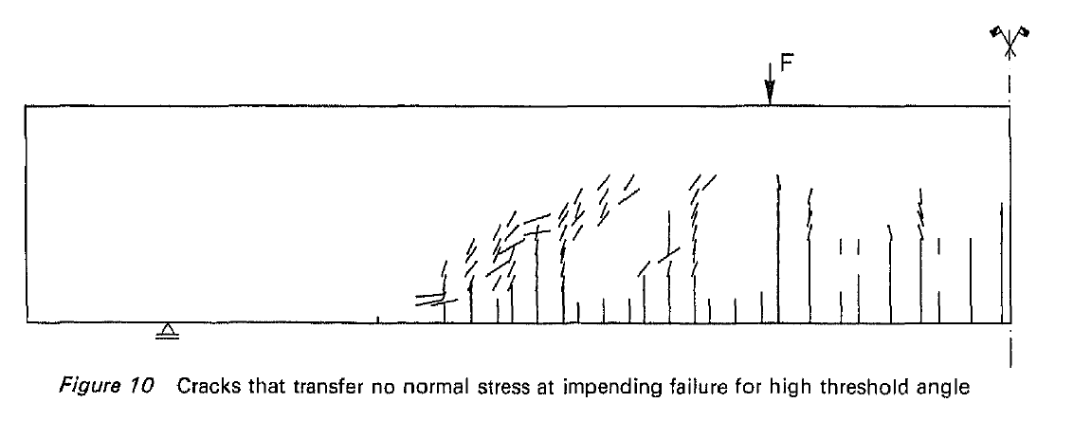
Smeared Crack Approach
Fixed crack approach:
  The orientation of the crack is chosen to be perpendicular to the direction of the principal tensile strain or stress
  The direction of the principal tensile strain or stress changes during loading -> too stiff response
  Leads to stress locking. The rotation of the principal strain axes after crack initiation builds up shear stresses
  Stresses transmitted even over wide-open cracks
Rotating crack approach
  The crack is rotated with the principal strain axis
  Rotating crack models also suffer from stress locking
  The directions of the maximum principal strain determined from the FE interpolation at individual Gauss points deviates from the normal to the macroscopic crack.
  The lateral principal stress has a nonzero projection on the crack normal, which generates cohesive forces acting across the crack even at late stages of the cracking process
Rotating crack model + scalar damage: all stress components tend to zero when crack opens widely
Rotating crack models combined with fixed crack: crack rotates up to a certain crack opening, the crack can rotate, it is then fixed
Non-orthogonal cracks (de Borst and Nauta 1985)
Rabczuk, T. (2013). Computational Methods for Fracture in Brittle and Quasi-Brittle Solids: State-of-the-Art Review and Future Perspectives. ISRN Applied Mathematics, 2013, 1–38. https://doi.org/10.1155/2013/849231
de Borst, R. and Nauta, P. (1985), "Non‐orthogonal cracks in a smeared finite element model", Engineering Computations, Vol. 2 No. 1, pp. 35-46. https://doi.org/10.1108/eb023599

Slide 4
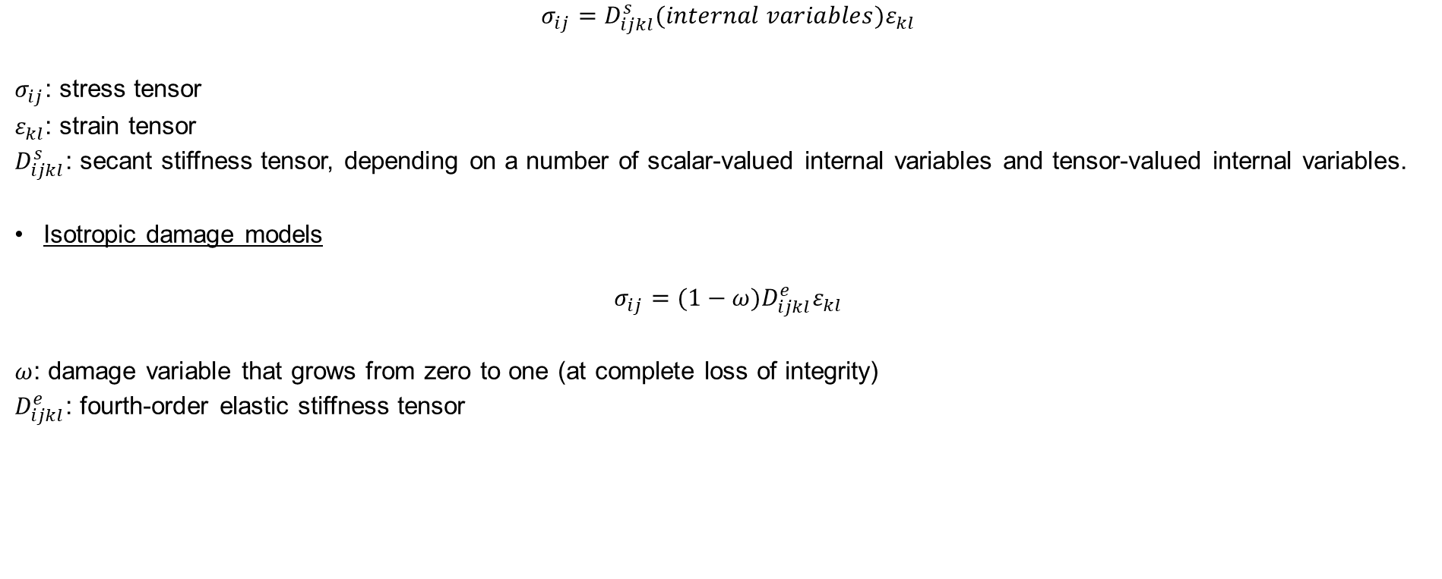
Damage mechanics framework
$$σ_{ij}=D_{ijkl}^{s}(internal variables)ε_{kl}$$
$σ_{ij}$: stress tensor
$ε_{kl}$: strain tensor
$D_{ijkl}^{s}$: secant stiffness tensor, depending on a number of scalar-valued internal variables and tensor-valued internal variables.
Isotropic damage models
$$σ_{ij}={(1−ω)D}_{ijkl}^{e}ε_{kl}$$
$ω$: damage variable that grows from zero to one (at complete loss of integrity)
$D_{ijkl}^{e}$: fourth-order elastic stiffness tensor
De Borst, R. (2001). Fracture in quasi-brittle materials: A review of continuum damage-based approaches. Engineering Fracture Mechanics, 69(2), 95–112. https://doi.org/10.1016/S0013-7944(01)00082-0

Slide 5
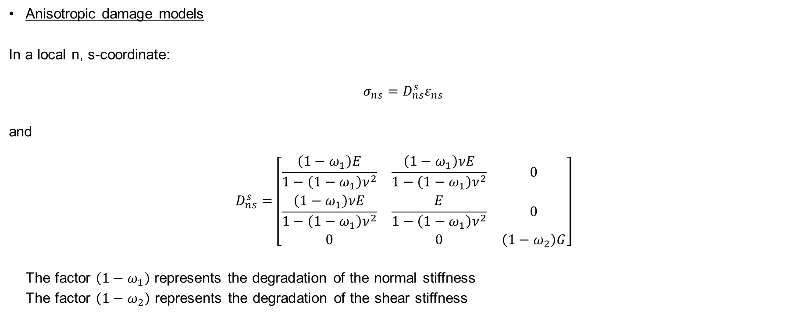
Damage mechanics framework (2)
Anisotropic damage models
In a local n, s-coordinate:
$$σ_{ns}=D_{ns}^{s}ε_{ns}$$
and
$$D_{ns}^{s}=\left[\begin{matrix}\frac{\left(1−ω_{1}\right)E}{1−\left(1−ω_{1}\right)ν^{2}} & \frac{\left(1−ω_{1}\right)νE}{1−\left(1−ω_{1}\right)ν^{2}} & 0 \\ \frac{\left(1−ω_{1}\right)νE}{1−\left(1−ω_{1}\right)ν^{2}} & \frac{E}{1−\left(1−ω_{1}\right)ν^{2}} & 0 \\ 0 & 0 & \left(1−ω_{2}\right)G\end{matrix}\right]$$
  The factor $\left(1−ω_{1}\right)$ represents the degradation of the normal stiffness
  The factor $\left(1−ω_{2}\right)$ represents the degradation of the shear stiffness
De Borst, R. (2001). Fracture in quasi-brittle materials: A review of continuum damage-based approaches. Engineering Fracture Mechanics, 69(2), 95–112. https://doi.org/10.1016/S0013-7944(01)00082-0

Slide 6
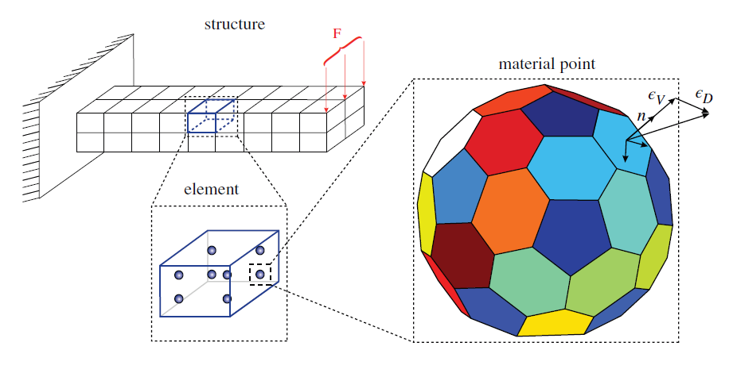
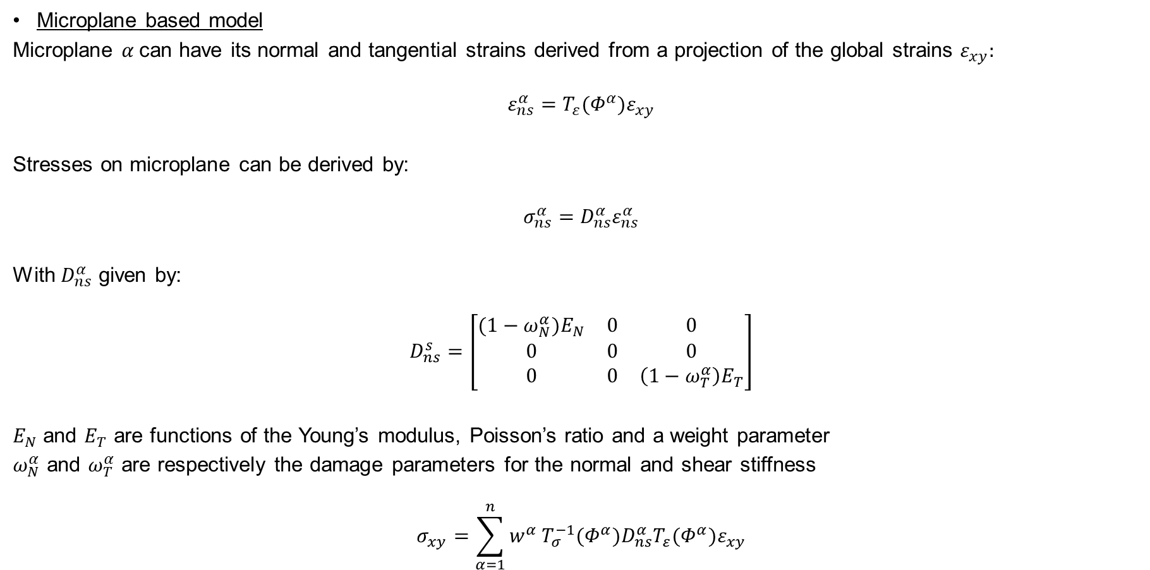
Damage mechanics framework (3)
Microplane based model
Microplane $α$can have its normal and tangential strains derived from a projection of the global strains $ε_{xy}:$
$$ε_{ns}^{α}=T_{ε}(Φ^{α})ε_{xy}$$
Stresses on microplane can be derived by:
$$σ_{ns}^{α}=D_{ns}^{α}ε_{ns}^{α}$$
With $D_{ns}^{α}$ given by:
$$D_{ns}^{s}=\left[\begin{matrix}(1−ω_{N}^{α})E_{N} & 0 & 0 \\ 0 & 0 & 0 \\ 0 & 0 & \left(1−ω_{T}^{α}\right)E_{T}\end{matrix}\right]$$
$E_{N}$ and $E_{T}$ are functions of the Young’s modulus, Poisson’s ratio and a weight parameter
$ω_{N}^{α}$ and $ω_{T}^{α}$ are respectively the damage parameters for the normal and shear stiffness
$$σ_{xy}=\sum_{α=1}^{n}{w^{α}}T_{σ}^{−1}(Φ^{α})D_{ns}^{α}T_{ε}(Φ^{α})ε_{xy}$$
Qinami, A., Pandolfi, A., & Kaliske, M. (2020). Variational eigenerosion for rate-dependent plasticity in concrete modeling at small strain. International Journal for Numerical Methods in Engineering, 121(7), 1388–1409. https://doi.org/10.1002/nme.6271
De Borst, R. (2001). Fracture in quasi-brittle materials: A review of continuum damage-based approaches. Engineering Fracture Mechanics, 69(2), 95–112. https://doi.org/10.1016/S0013-7944(01)00082-0
Bazant. (1989). MICROPLANE MODEL FOR BRITTLE-PLASTIC MATERIAL: I. THEORY By Zdenek P. Bazant, 1 Fellow, ASCE, and Pere C. Prat, 2 Student Member, ASCE. 114(10), 1672–1688.

Slide 7
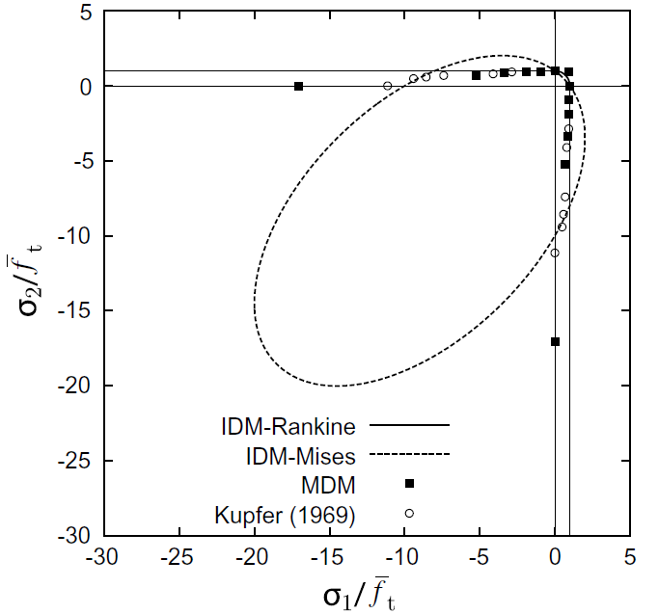
Isotropic vs Anisotropic damage models
Main conclusions from comparative studies (concrete):
Isotropic damage model with a realistic biaxial strength envelope (Rankine Isotropic Damage Model)
  Strongly sensitive to mesh orientation
  Even if the mesh is fine
Isotropic damage model with a modified von Mises definition of equivalent strain
  Appears to be less sensitive to the mesh orientation
  This is to a large extent an artifact caused by the unrealistic increase of tensile strength under compression parallel to the crack
Anisotropic damage model (Microplane-based Damage Model)
  Can reasonably well capture arbitrary crack trajectories
  The biaxial strength envelope remains close to typical experimental data for concrete
Mesh refinement often reduces sensitivity to the mesh orientation, but is not a universal remedy
Biaxial strength envelope for different damage models and experimental data by Kupfer et al. 1969. (Jirásek and Grassl 2008)
Jirásek, M., & Grassl, P. (2008). Evaluation of directional mesh bias in concrete fracture simulations using continuum damage models. Engineering Fracture Mechanics, 75(8), 1921–1943. https://doi.org/10.1016/j.engfracmech.2007.11.010
Grassl, P., & Jirásek, M. (2004). On mesh bias of local damage models for concrete. Proc., 5th Int. Conf. on Fracture Mech. of Concrete Structures (FraMCoS-5), 5, 255–262.
Fichant, S., La Borderie, C., & Pijaudier-Cabot, G. (1998). A comparative study of isotropic and anisotropic descriptions of damage in concrete structures. Studies in Applied Mechanics, 46(C), 259–274. https://doi.org/10.1016/S0922-5382(98)80046-9
Fichant, S., Pijaudier-Cabot, G., & La Borderie, C. (1997). Continuum damage modelling : Approximation of crack induced anisotropy. Mechanics Research Communications, 24(2), 109–114. https://doi.org/10.1016/s0093-6413(97)00001-3

Slide 8
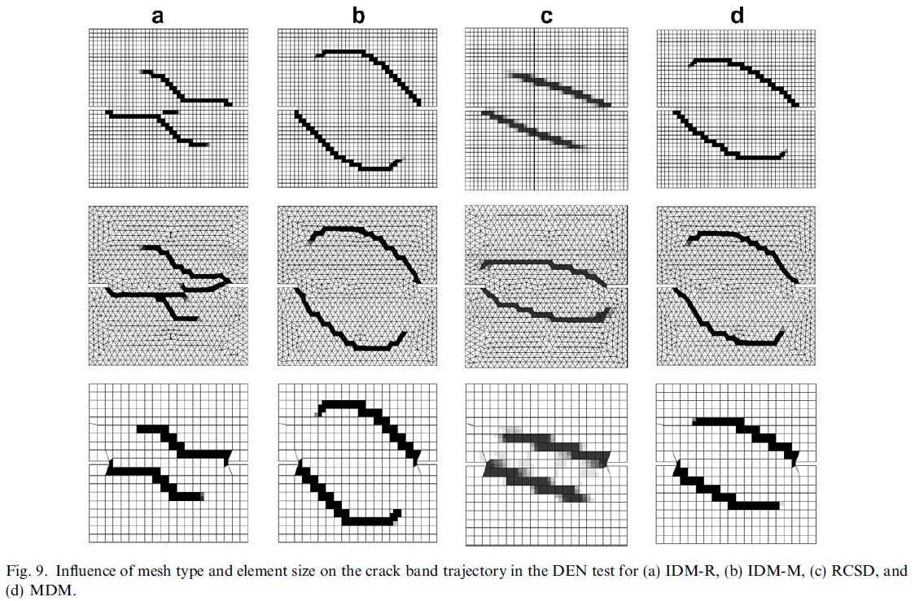
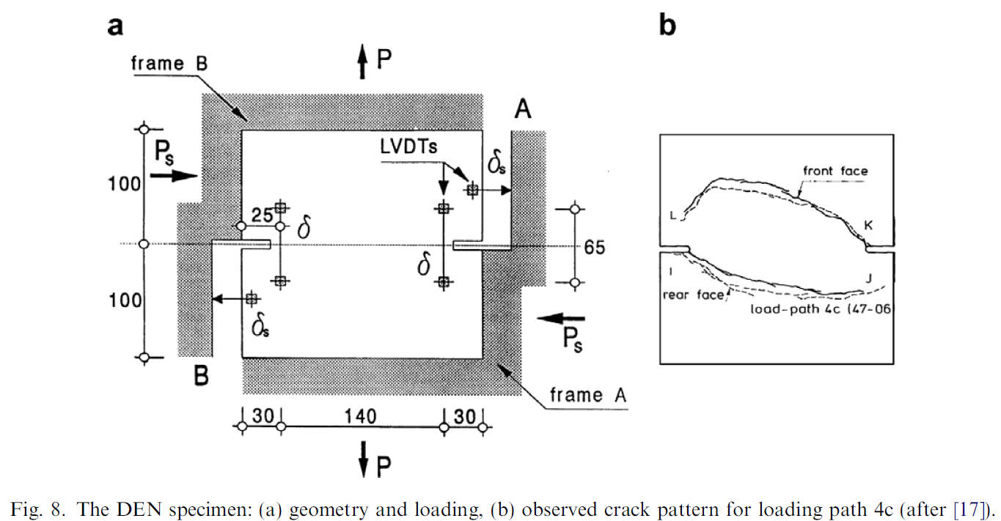
Isotropic vs Anisotropic damage models (2)
Experimentally observed crack paths
Jirásek, M., & Grassl, P. (2008). Evaluation of directional mesh bias in concrete fracture simulations using continuum damage models. Engineering Fracture Mechanics, 75(8), 1921–1943. https://doi.org/10.1016/j.engfracmech.2007.11.010

Slide 9
Anisotropic continuum damage models
Fourth-order damage tensor
Second-order damage tensor
  More popular
  Simplicity to represent three orthogonal families of microcracks
  Capability to model metals or quasi-brittle materials
Lemaitre, Desmorat and Sauzay (2000)
  Implemented on Metafor
  Second-order damage tensor
  One of the most popular damage-based anisotropic models
  Strain equivalence principle
  Partition between the deviatoric part and the hydrostatic part of the elastic energy
Improvement proposed by Desmorat (2015)
  Damage state is described using the integrity tensor instead of the damage tensor
  Gradual softening and numerical stability
Bargellini, Halm and Dragon (2008)
  Introduction of a finite set of microcrack densities associated with a fixed direction
  Avoids inconveniences encountered when using a single second order tensor damage variable
    Non uniqueness of the free energy
    Spurious dissipation at crack closure
  Frictional sliding on closed microcracks is introduced as an additional dissipative mechanism (second-order sliding variable)
  Young’s and shear’s moduli restored at microcrack closure
Zafati, E., & Richard, B. (2019). Anisotropic continuum damage constitutive model to describe the cyclic response of quasi-brittle materials: The regularized unilateral effect. International Journal of Solids and Structures, 162, 164–180. https://doi.org/10.1016/j.ijsolstr.2018.12.009

Slide 10
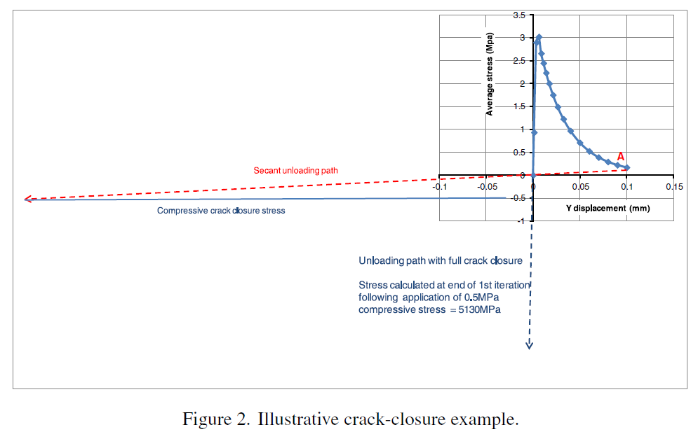
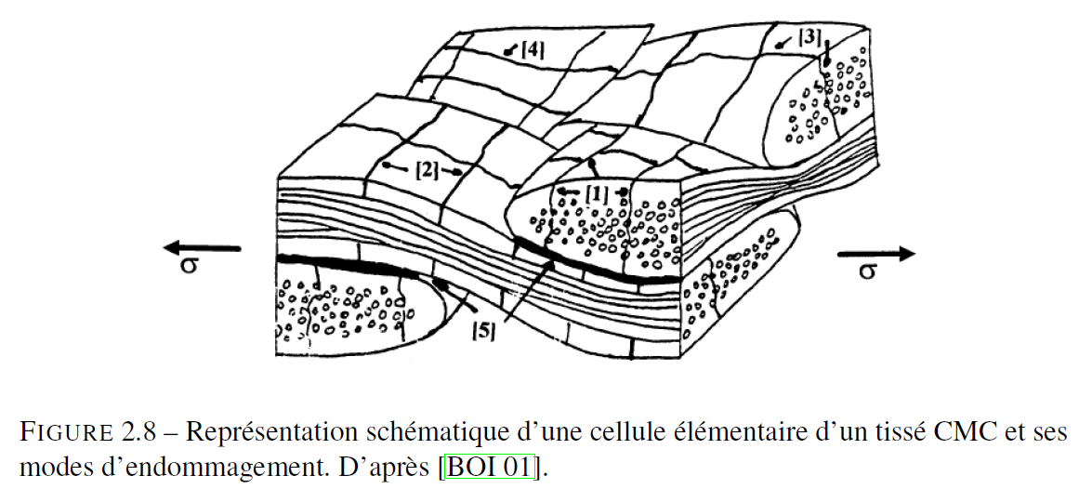
Continuum damage models
Jefferson and Mihai (2015)
  Smeared crack approach
  Smoothening of crack closure contact (to avoid abruptness and numerical issues)
  Shear contact behavior when opened cracks are loaded in shearing
  Stress criterion for crack initiation
  Isotropic damage
Ladevèze approach (LMT-Cachan):
  First main idea: Damage kinematic is completely free and specified the evolution laws
  Separate the contributions of the different crack networks (phenomenological)
  Objective: obtain a mechanical model that can be linked to a physico-chemical one to treat environmental degradation and self-healing aspects
Jefferson, A. D., and Mihai, I. C. (2015) The simulation of crack opening–closing and aggregate interlock behaviour in finite element concrete models. Int. J. Numer. Meth. Engng, 104: 48– 78. doi: 10.1002/nme.4934.

Slide 11
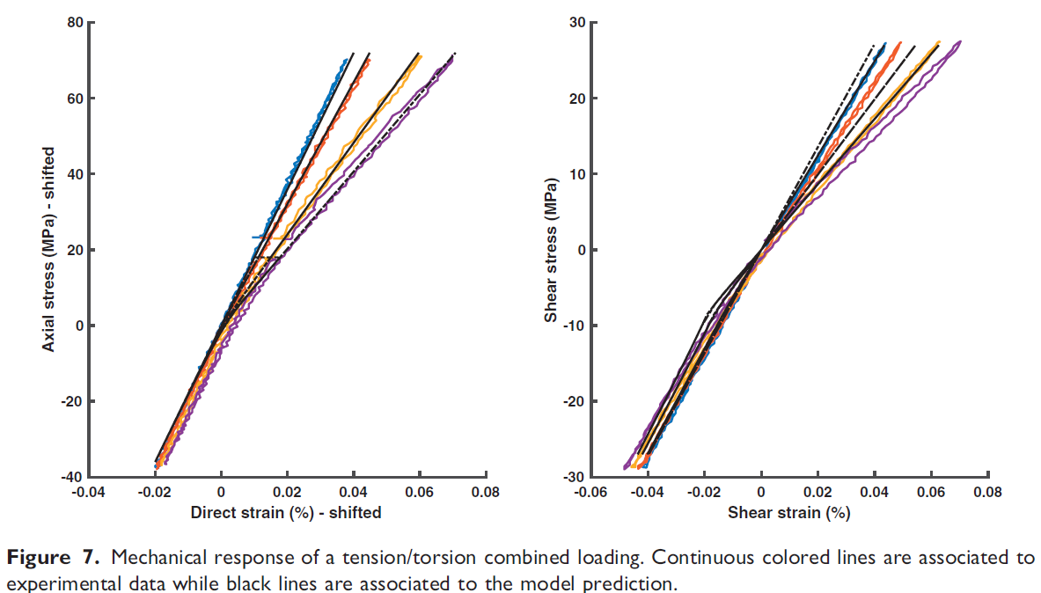
Anisotropic continuum damage models
Continuation on Ladevèze-based models
  Emmanuel Baranger used Ladevèze’s approach in several papers, considering damage on the mesoscale (woven)
    Baranger (2018) proposes an extension to the model in order to improve its performance when multi-axial non-proportional loading is applied
    Baranger (2019) builds upon the model to take into account unilateral contact and friction between crack lips
  Ph.D. thesis of Guillaume Couégnat (2008) considers micro and mesoscale damage by introducing discrete damage
  Genet et al. (2012) introduces environmental damage and self-healing to obtain a lifetime prediction
Baranger, E. (2018). Extension of a fourth-order damage theory to anisotropic history: Application to ceramic matrix compostites under a multi-axial non-proportional loading. International Journal of Damage Mechanics, 27(2), 238–252. https://doi.org/10.1177/1056789516674766
Baranger, E. (2019). Accounting for frictional contact in an anisotropic damage model based on compliance tensorial variables, illustration on ceramic matrix composites. International Journal of Damage Mechanics, 28(8), 1150–1169. https://doi.org/10.1177/1056789518812932
Guillaume Couégnat. Approche multiéchelle du comportement mécanique de matériaux composites à renfort tissé. Mécanique [physics.med-ph]. Université Sciences et Technologies - Bordeaux I, 2008. Français. tel-00403885
Genet, M., Marcin, L., Baranger, E., Cluzel, C., Ladevèze, P., & Mouret, A. (2012). Computational prediction of the lifetime of self-healing CMC structures. Composites Part A: Applied Science and Manufacturing, 43(2), 294–303. https://doi.org/10.1016/j.compositesa.2011.11.004

Slide 12
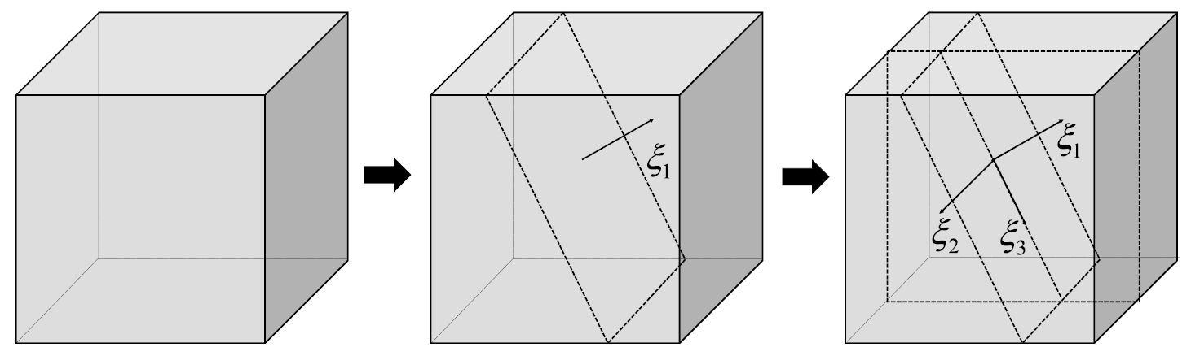
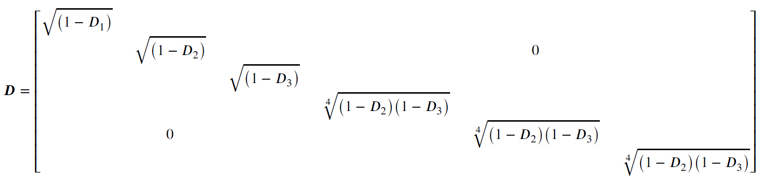
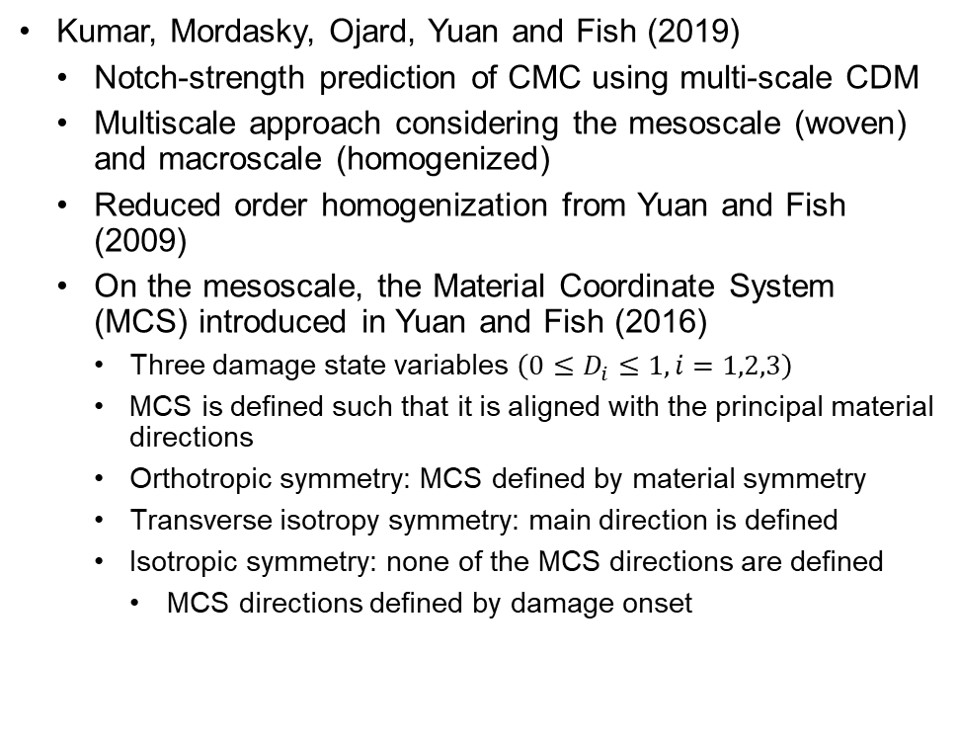
Anisotropic continuum damage models
Kumar, Mordasky, Ojard, Yuan and Fish (2019)
  Notch-strength prediction of CMC using multi-scale CDM
  Multiscale approach considering the mesoscale (woven) and macroscale (homogenized)
  Reduced order homogenization from Yuan and Fish (2009)
  On the mesoscale, the Material Coordinate System (MCS) introduced in Yuan and Fish (2016)
    Three damage state variables $\left(0≤D_{i}≤1, i=1,2,3\right)$
    MCS is defined such that it is aligned with the principal material directions
    Orthotropic symmetry: MCS defined by material symmetry
    Transverse isotropy symmetry: main direction is defined
    Isotropic symmetry: none of the MCS directions are defined
      MCS directions defined by damage onset
Definition of the MCS: (1) isotropic elastic material (left); (2) one direction of the MCS is determined by onset of damage (center); (3) all three directions of the MCS are determined due to onset of damage on a second plane (right).
Fourth-order damage tensor (Voigt’s notation)
Yuan, Z., & Fish, J. (2016). Are the cohesive zone models necessary for delamination analysis? Computer Methods in Applied Mechanics and Engineering, 310, 567–604. https://doi.org/10.1016/j.cma.2016.06.023
Kumar, R. S., Mordasky, M., Ojard, G., Yuan, Z., & Fish, J. (2019). Notch-strength prediction of ceramic matrix composites using multi-scale continuum damage model. Materialia, 6(February), 100267. https://doi.org/10.1016/j.mtla.2019.100267
Yuan, Z., & Fish, J. (2009). Multiple scale eigendeformation-based reduced order homogenization. Computer Methods in Applied Mechanics and Engineering, 198(21–26), 2016–2038. https://doi.org/10.1016/j.cma.2008.12.038

Slide 13
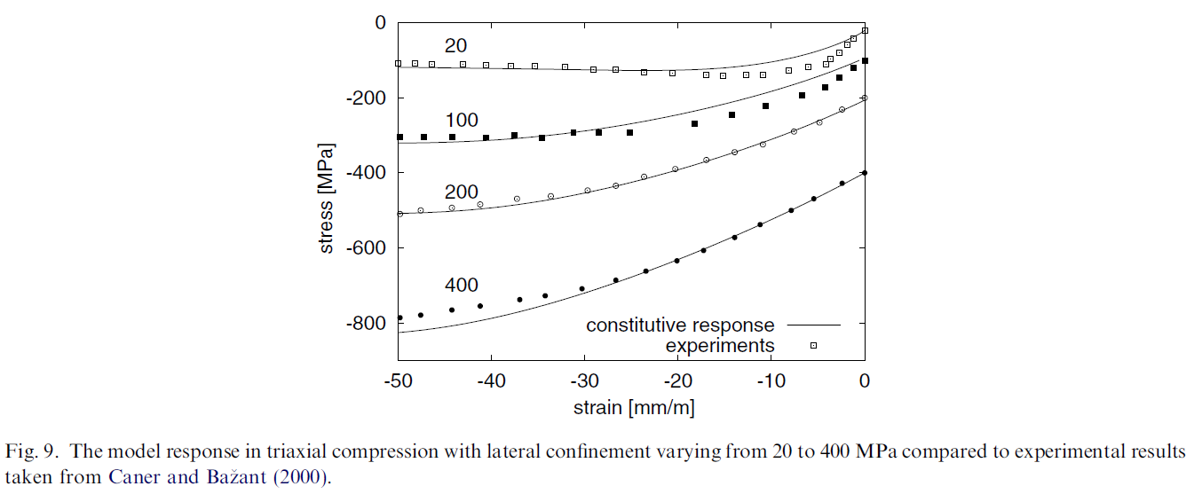
Anisotropic continuum damage models
Mengoni and Ponthot (2015)
  Numerical integration for an anisotropic continuum damage model coupled to elasto-plasticity in a finite strain context
  Staggered scheme of integration instead of a fully coupled integration algorithm
  Solves two decoupled systems – plasticity and anisotropic linear damage
  Restricted to materials that:
    Can be modelled with a von-Mises elasto-plastic model and isotropic hardening in its undamaged state
  Same principle of integration can be used with other plastic criteria if the plastic update respects some conditions
Possibility to couple with a damage-plastic model for quasi-brittle materials?
  Grassl and Jirásek (2006)
    Triaxial damage-plastic model for the failure of concrete
    Plasticity based on the effective stress
    Damage model driven by the plasticity strain
Mengoni, M., & Ponthot, J. P. (2015). A generic anisotropic continuum damage model integration scheme adaptable to both ductile damage and biological damage-like situations. International Journal of Plasticity, 66, 46–70. https://doi.org/10.1016/j.ijplas.2014.04.005
Grassl, P., & Jirásek, M. (2006). Damage-plastic model for concrete failure. International Journal of Solids and Structures, 43(22–23), 7166–7196. https://doi.org/10.1016/j.ijsolstr.2006.06.032

Slide 14
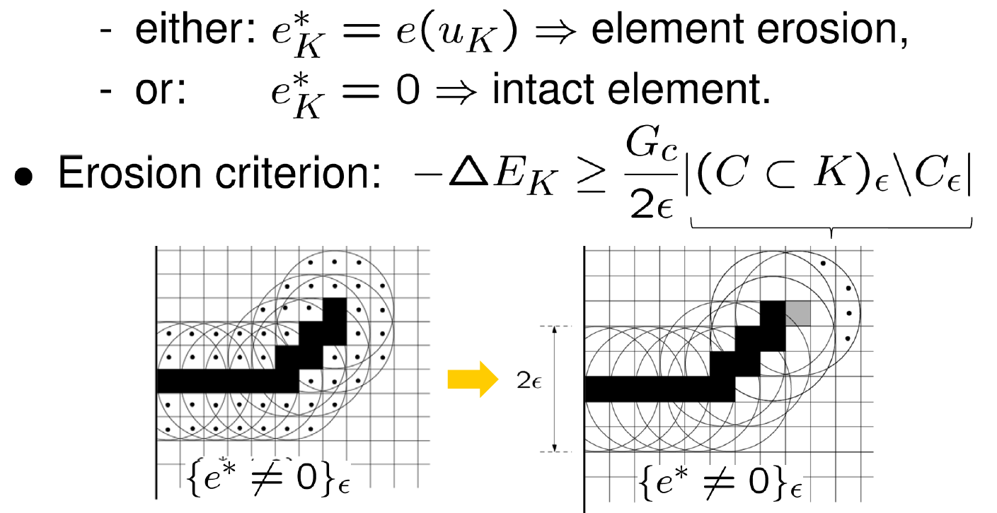
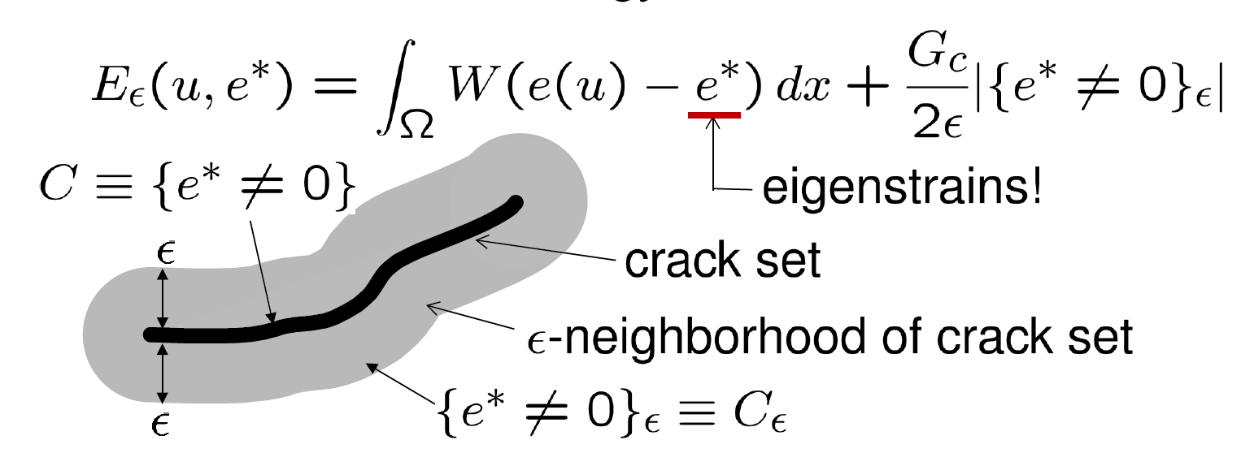

Eigenfracture
Fracture as an energy-relaxation process
For every element K:
Total incremental energy: Elastic + fracture
To first order: $−∆E_{K}\sim$energy in element K
Mesh insensitive
Verified with 3D mixed mode cracking
Pandolfi, A. and Ortiz, M. (2012), An eigenerosion approach to brittle fracture. Int. J. Numer. Meth. Engng, 92: 694-714. https://doi.org/10.1002/nme.4352

Slide 15
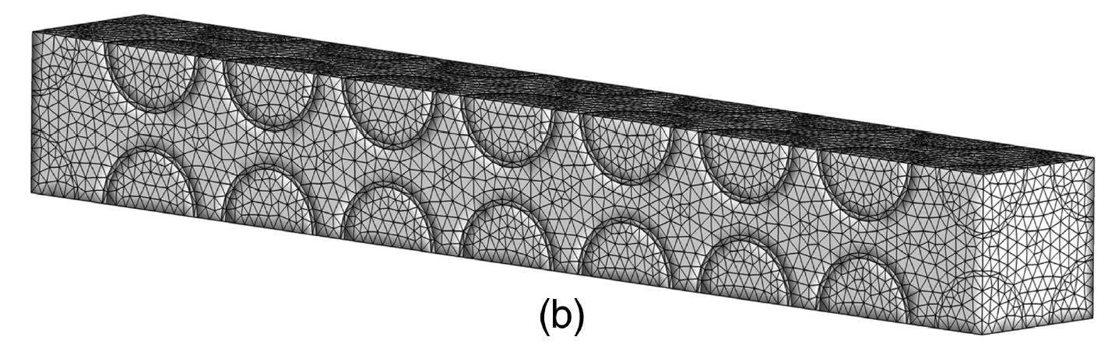
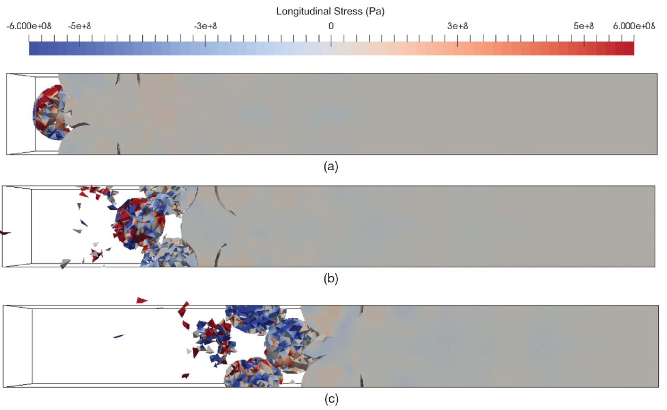
Eigenfracture
Continuation of the approach
Mitchell, Pandolfi and Ortiz (2016)
  Effect of Brittle Fracture in a Metaconcrete Slab under Shock Loading
  Metaconcrete:
    Engineered inclusion with a heavy core and a compliant outer layer
Qinami et al. (2019)
  Adaptive mesh techniques to further reduce mesh bias when using eigenerosion
Qinami, Pandolfi and Kaliske (2020)
  Use of eigenerosion combined with a rate-dependent Drucker-Prager viscoelastic model and microplane method
Mitchell, S. J., Pandolfi, A., & Ortiz, M. (2016). Effect of Brittle Fracture in a Metaconcrete Slab under Shock Loading. Journal of Engineering Mechanics, 142(4), 04016010. https://doi.org/10.1061/(asce)em.1943-7889.0001034
Qinami, A., Bryant, E. C., Sun, W. C., & Kaliske, M. (2019). Circumventing mesh bias by r- and h-adaptive techniques for variational eigenfracture. International Journal of Fracture, 220(2), 129–142. https://doi.org/10.1007/s10704-019-00349-x
Qinami, A., Pandolfi, A., & Kaliske, M. (2020). Variational eigenerosion for rate-dependent plasticity in concrete modeling at small strain. International Journal for Numerical Methods in Engineering, 121(7), 1388–1409. https://doi.org/10.1002/nme.6271

Slide 16
Comparison table between damage models
Approach | Damage initiation criterion | Mesh dependance | Evolution from damage to fracture | Crack closure and friction
Original Smeared Crack Approach | Strength | Very strong | Crack remains a continuum | -
Crack band theory | Fracture energy | Non negligeable | Crack remains a continuum | Some models based on the crack band theory include unilateral contact
Isotropic CDM models | Strain or stress | Can be strong | Crack remains a continuum | Can be included
Anisotropic CDM models | Strain or stress | Weak | Crack remains a continuum | Can be included
Microplane-based damage model | Normal strain in a given direction | Weak | Crack remains a continuum | No mention of crack closure under compression or friction
Eigenfracture | Energy on crack tip neighborhood | Weak | Erosion of elements belonging to crack set | Crack closure condition is respected

Slide 17
Concluding remarks
Many options of continuum damage models for quasi-brittle materials
Compromise between very strong discontinuity and numerical stability
  Most of the regularization methods are also supported by experimental evidences
Balance between representation of many phenomena and CPU cost
  More than one scale to be simulated
Isotropic damage models can struggle to predict crack path caused by multiaxial loadings

Slide 18
Appendix

Slide 19
Mesh-objective two-scale finite element analysis of damage and failure in ceramic matrix composites
Pascal Meyer and Anthony M. Waas - 2015
University of Washington

Slide 20
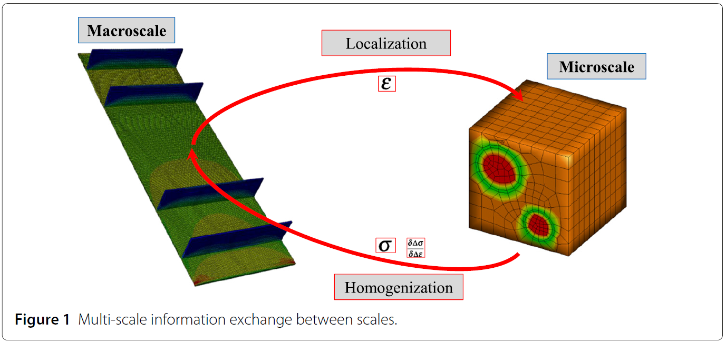
Integrated Finite Element Method (IFEM)
Approche
Principe:
Abaqus utilisé pour générer un modèle à l’échelle du stratifié UD
Un deuxième modèle dans une échelle inférieure est intégré avec le solveur Abaqus principal par une sous-routine utilisateur (UMAT)
  VER microstructural inclut tous les constituants du matériau réel
    Fibre
    Matrice
    Interface fibre/matrice
  Détails géométriques
    Positions relatives des fibres
    Variabilité du diamètre
  Hétérogénéités dans les propriétés matériaux

Slide 21
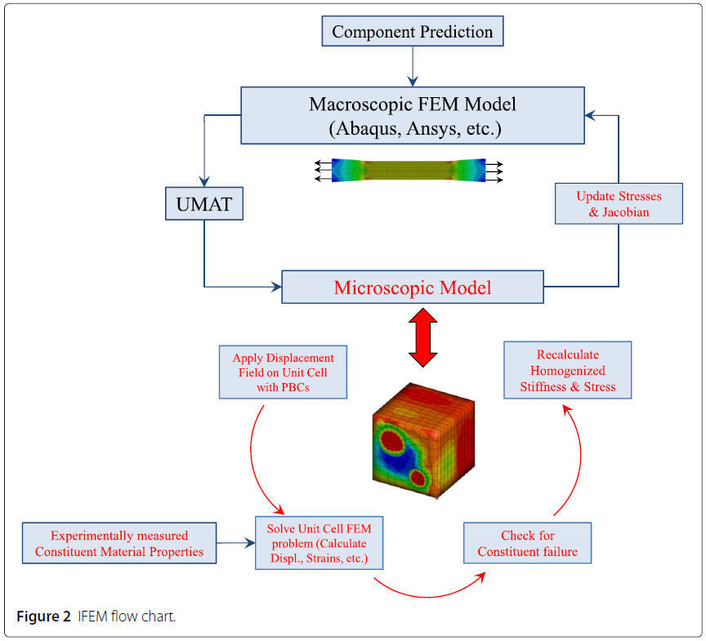
Flow chart
Méthode:
Le calcul des deux échelles est réalisé utilisant la méthode implicite dans Abaqus
IFEM développé en Fortran et tourné dans un environnement de cluster
La sous-routine est appelé pour chaque point d’intégration des éléments définies comme « user material »
Dans l’échelle microscopique le modèle énergétique Crack Band Theory (CBT) pour prédire les microfissurations des constituants

Slide 22
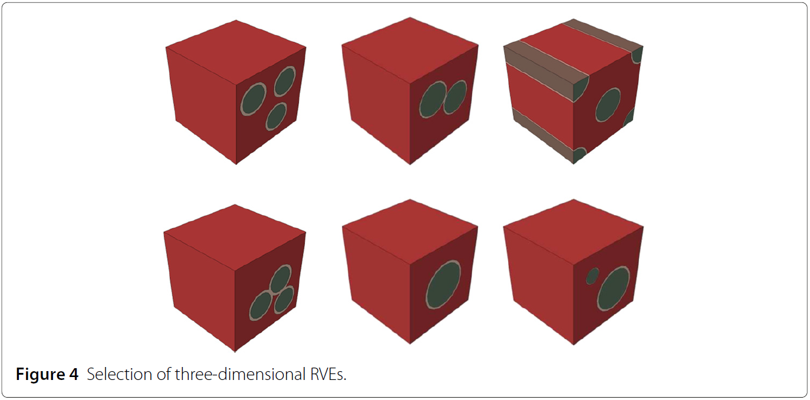
Caractéristiques du VER
Nombre de fibres par VER limité à 3 (choix lié au coût de calcul)
Chaque élément du modèle macroscopique utilise un VER légèrement différent des VER’s environnants
Variations:
  Nombre de fibres
  Position relative des fibres (fibres en contact inclus)
  Diamètre des fibres
La variation spatiale des propriétés matériaux (contrainte à rupture, ténacité, etc.) ne sont pas abordés dans les VER’s de cette étude
  Proposés pour études futures
Les porosités ne sont pas modélisées

Slide 23
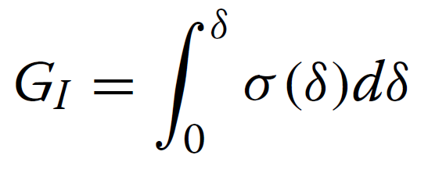
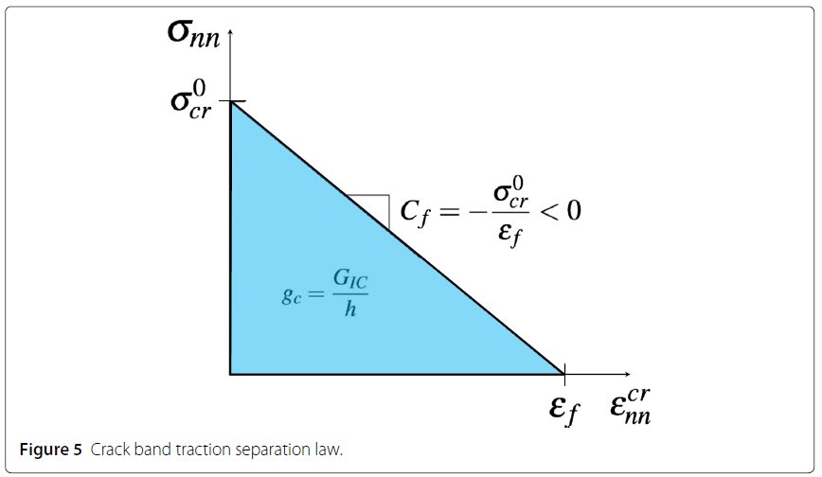

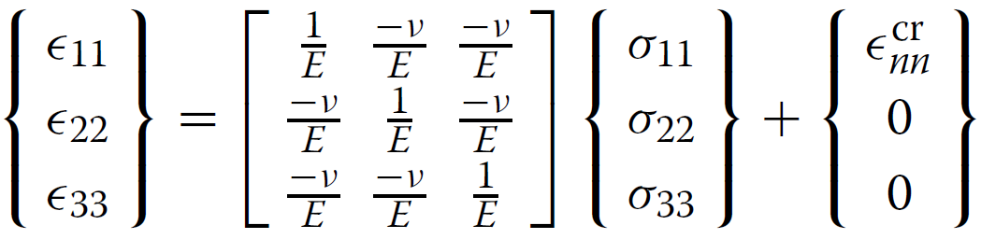
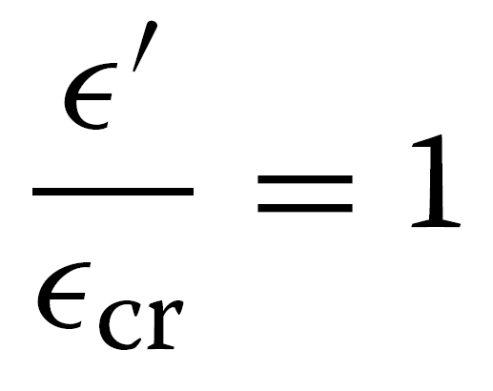
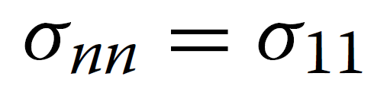
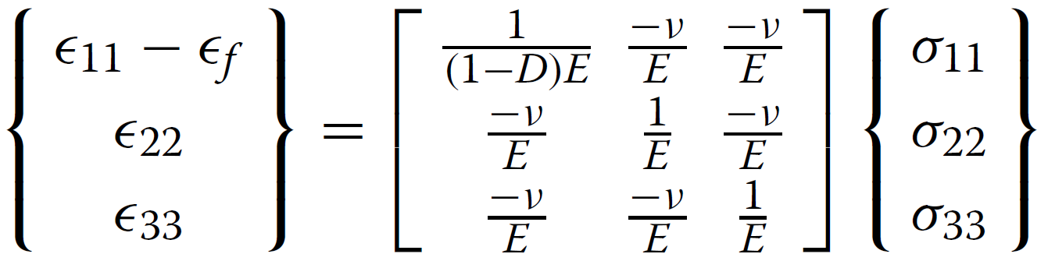
Crack band failure model
Taux de dissipation d’énergie :
Fissures ne sont pas modélisées explicitement
Fissures sont incorporées à la loi constitutive du matériau
Hypothèse :
Seulement le mode I est considéré
Critère d’endommagement :
Crack opening
Normal traction
Déformation d’un élément :
Maximum principal strain
Strain to failure (material parameter)

Slide 24
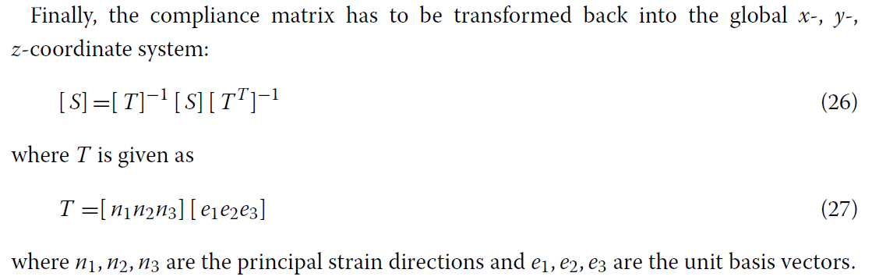
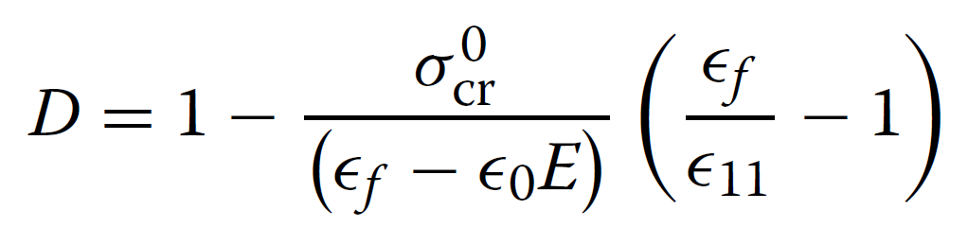
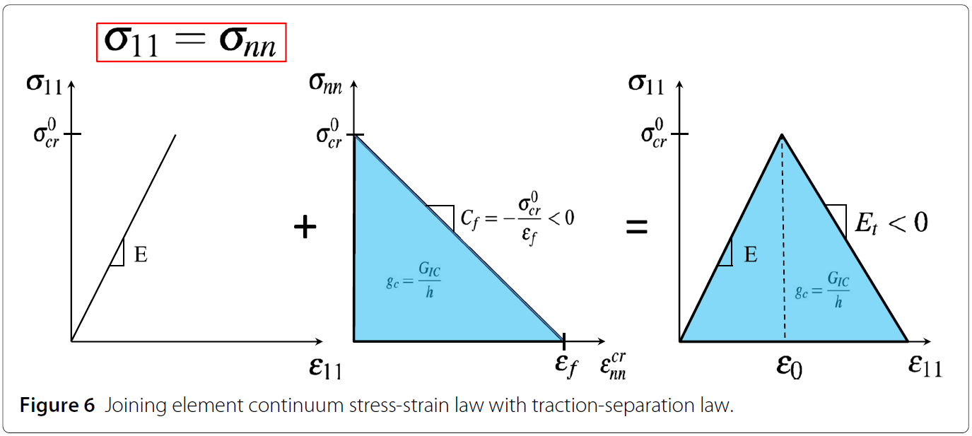
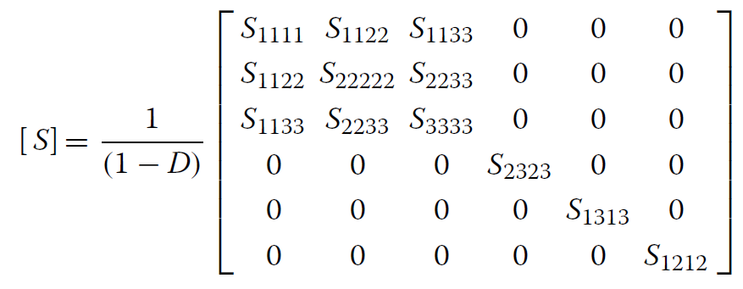
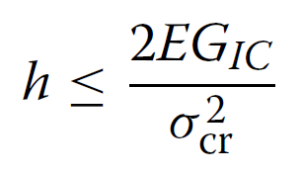
Crack band failure model
Damage
Endommagement est considéré isotrope, la matrice de souplesse est donnée par :
h : Characteristic length scale
length over which the crack opening is ‘smeared’ in order to define the effective strain due to cracking

Slide 25
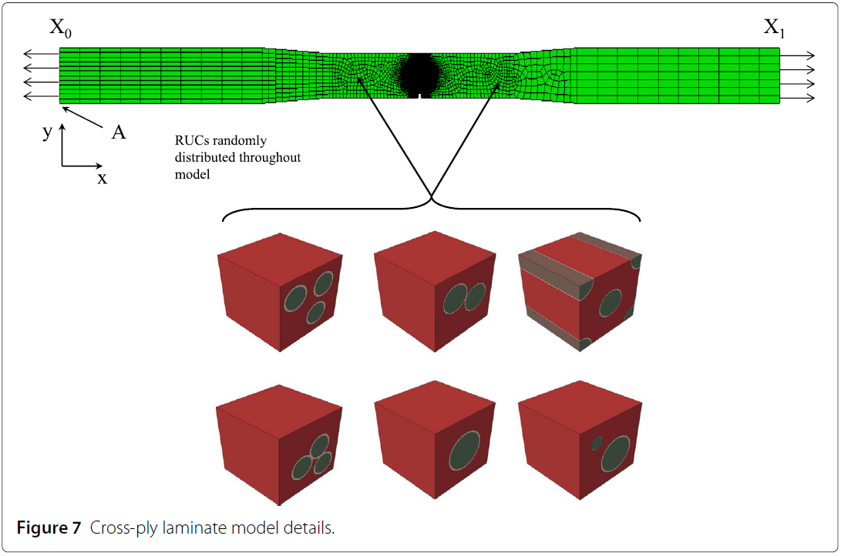
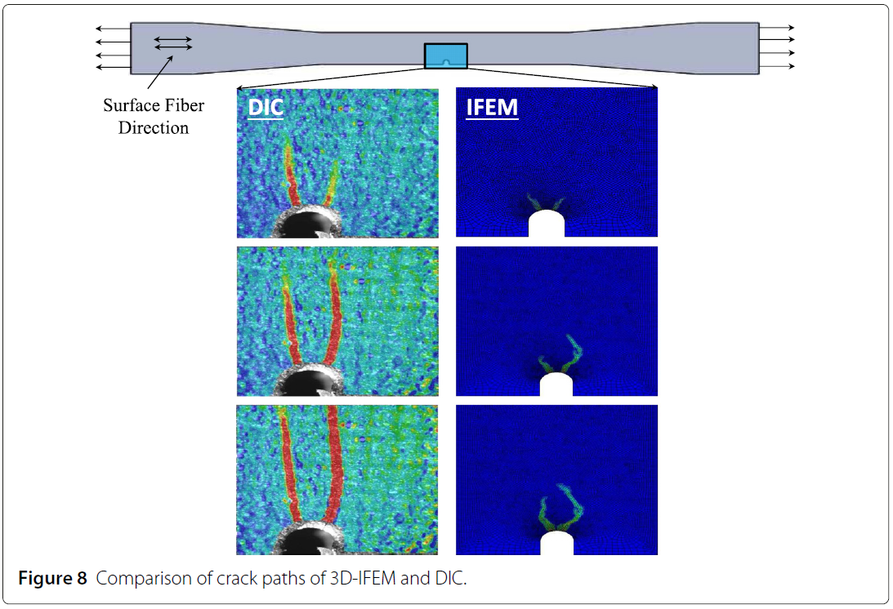
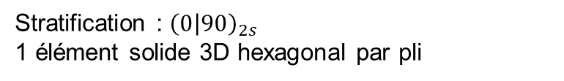
Résultats
Stratifié CMC entaillé
Stratification : ${\left(0 | 90\right)}_{2s}$
1 élément solide 3D hexagonal par pli

Slide 26
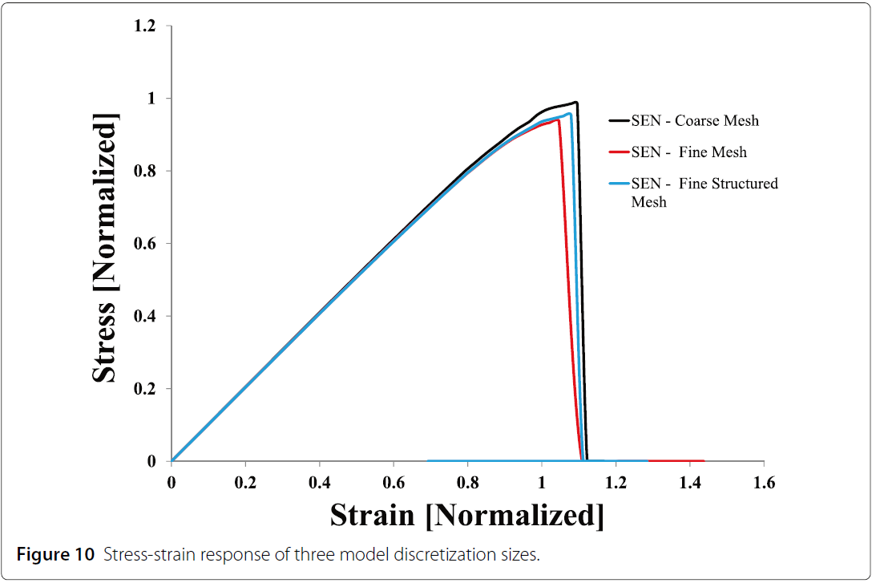
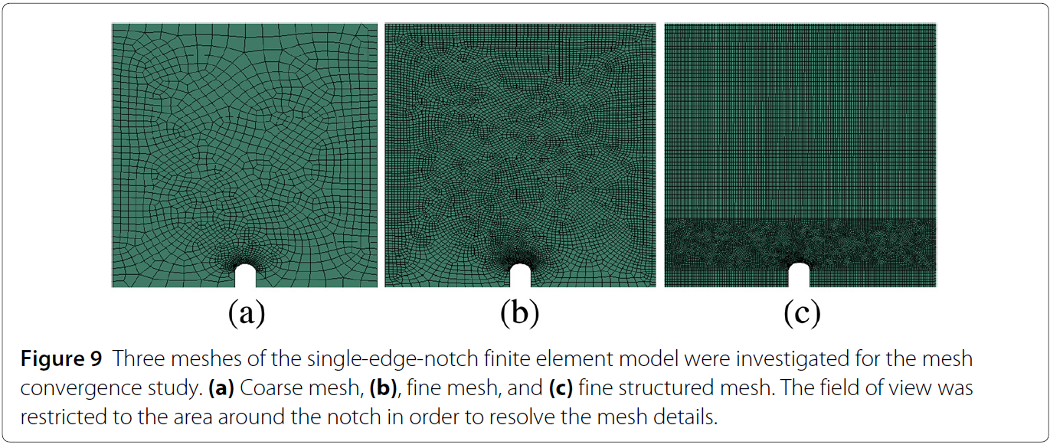
Résultats
Dépendance du maillage

Slide 27
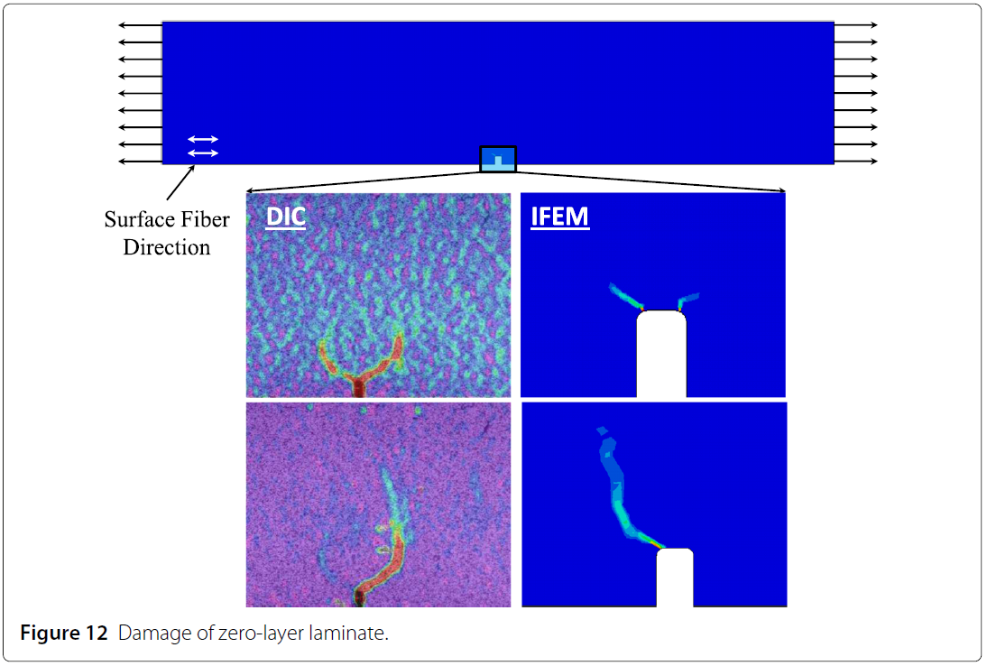
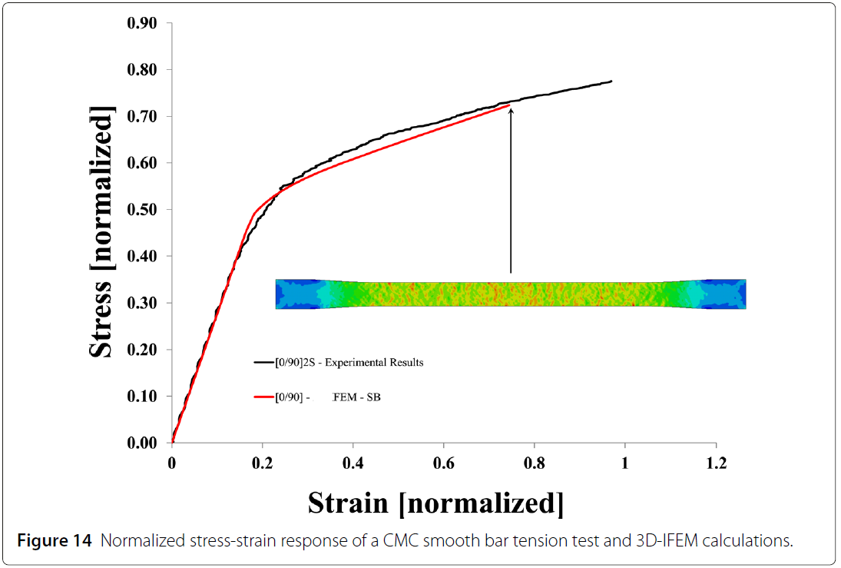
Résultats
Plaque UD et Stratifié ${\left(0 | 90\right)}_{2s}$ non entaillé

